Slide 1


Presentation of 1st assignment - ece439
Dimitrios Tsalapatas
03246
Algorithm cad 2
14/04/2024

Slide 2
Concept
Make a gui (graphical user interface) for Cad tool that supports:
Layout with some random located cells and wires
zoom-in / zoom-out using mouse scroll
middle-click of mouse reset zoom of every item
Use scrollbars to move canva horizontal and verical
Add clipping to don’t draw items when should not

Slide 3
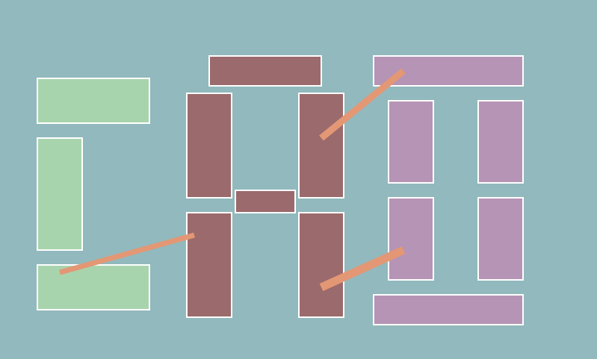
Layout of GUI
We create a layout for canva with dimensions 800 x 650 and we add some random Cells with different height and width that make word “CAD”
Also, we add some lines that represent wires
In order to add a rectangle we use cairo and some functions of it
cairo_set_source_rgb(maincanvas, Red, Green, Blue)
cairo_rectangle(maincanvas, x_pos, y_pos, width, height)
cairo_fill(maincanvas)

Slide 4
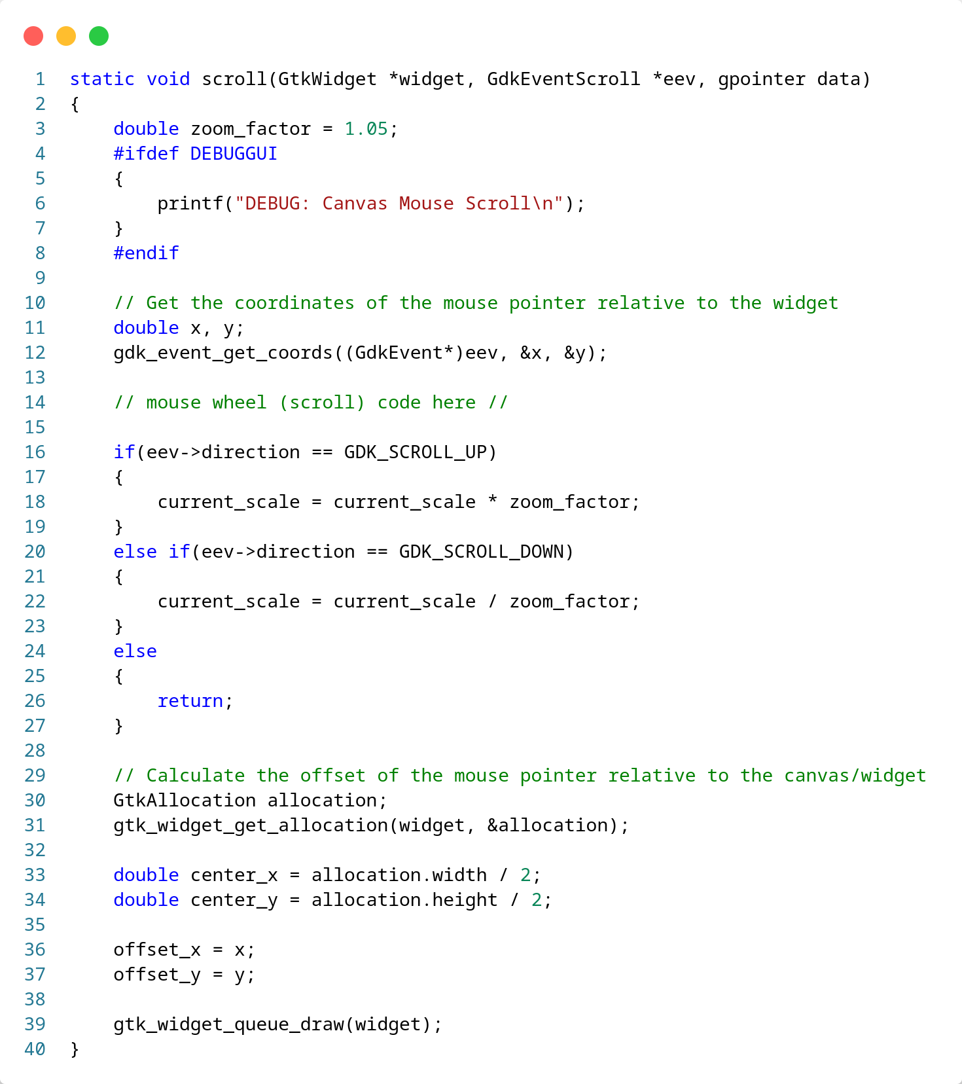
Zoom-in / Zoom-out
We set variable zoom_factor as 1.05 so that zoom will be smooth.
We change current_scale of canva, by zoom_factor according to if we scroll_up or scroll_down.
Then, we get position of mouse x, y in order to draw cells correct

Slide 5
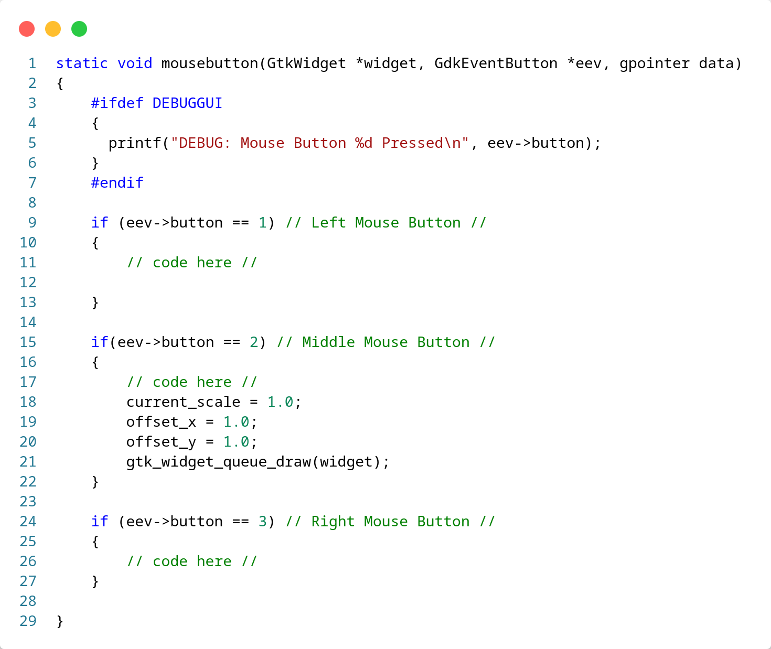
Zoom reset
We just use event o middle-click to reset variable current_scale to 1.0 and offset_x and offset_y to 0 in order to reset scale of all items

Slide 6
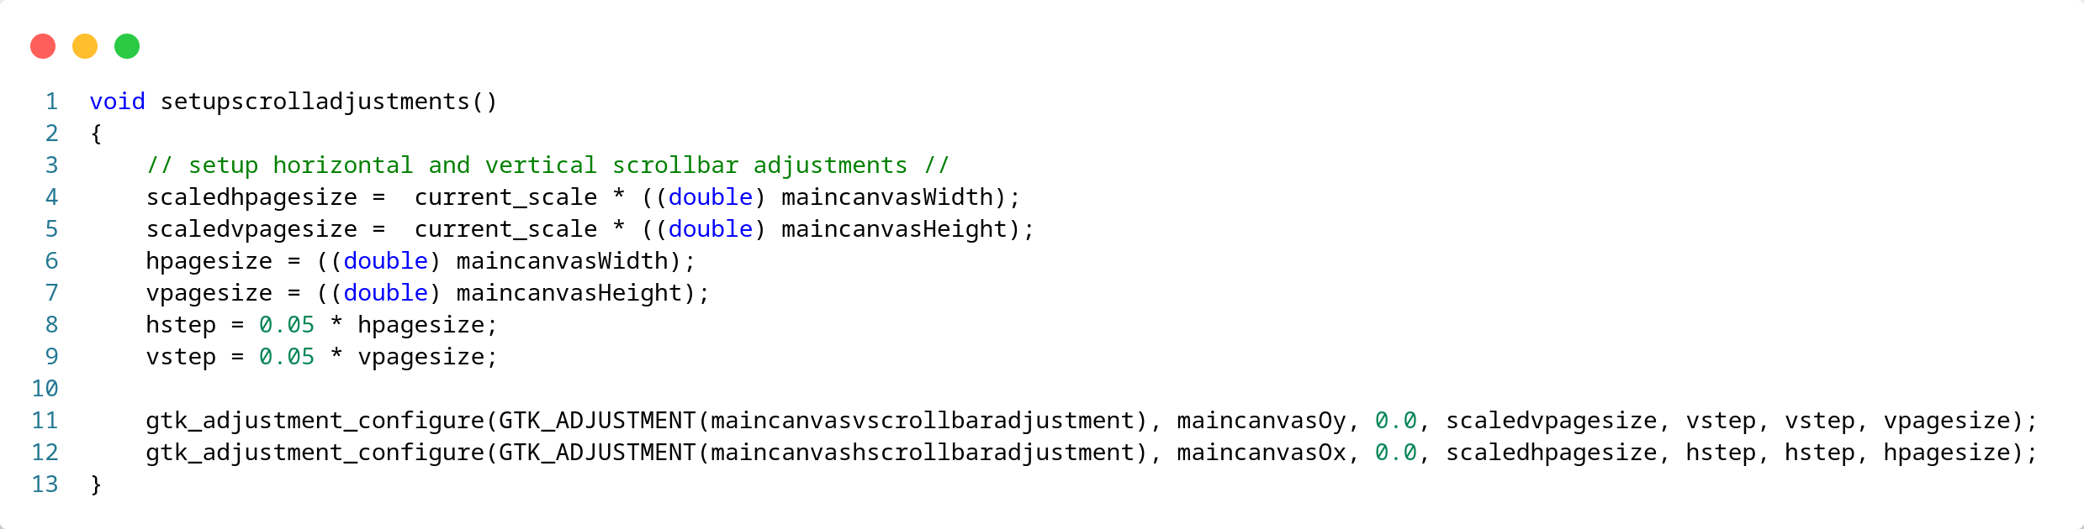
Scrollbars Functionality
scaledhpagesize: new maximum value
hpagesize: new page size
hstep: new step increment

Slide 7
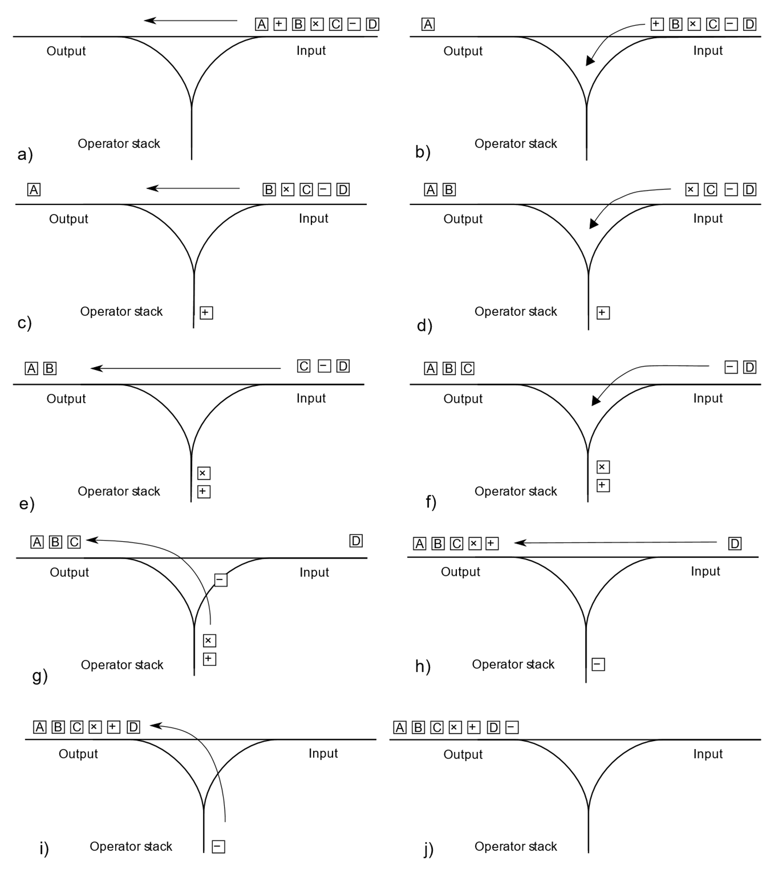
Convert Expression
It is necessary to convert the logic expression user gave us, from infix to postfix to be easier to analyze the expression
In order to achieve this we use Shunting yard algorithm
Example:
Infix: A+B*C*(D+A)
Postfix: ABC*DA+*+

Slide 8
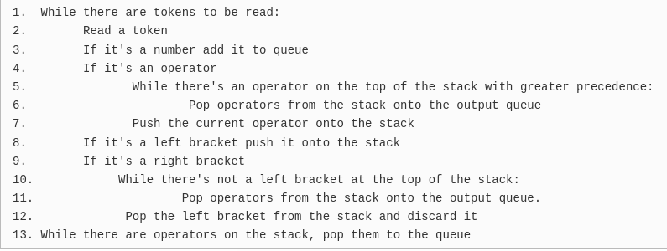
Convert Expression
To implement this algorithm, we need to create a stack of char* type.
We create basic functions for this like:
Create_stack
Push
Pop
Peek
IsEmpty
Delete_stack
Pseudo-code

Slide 9
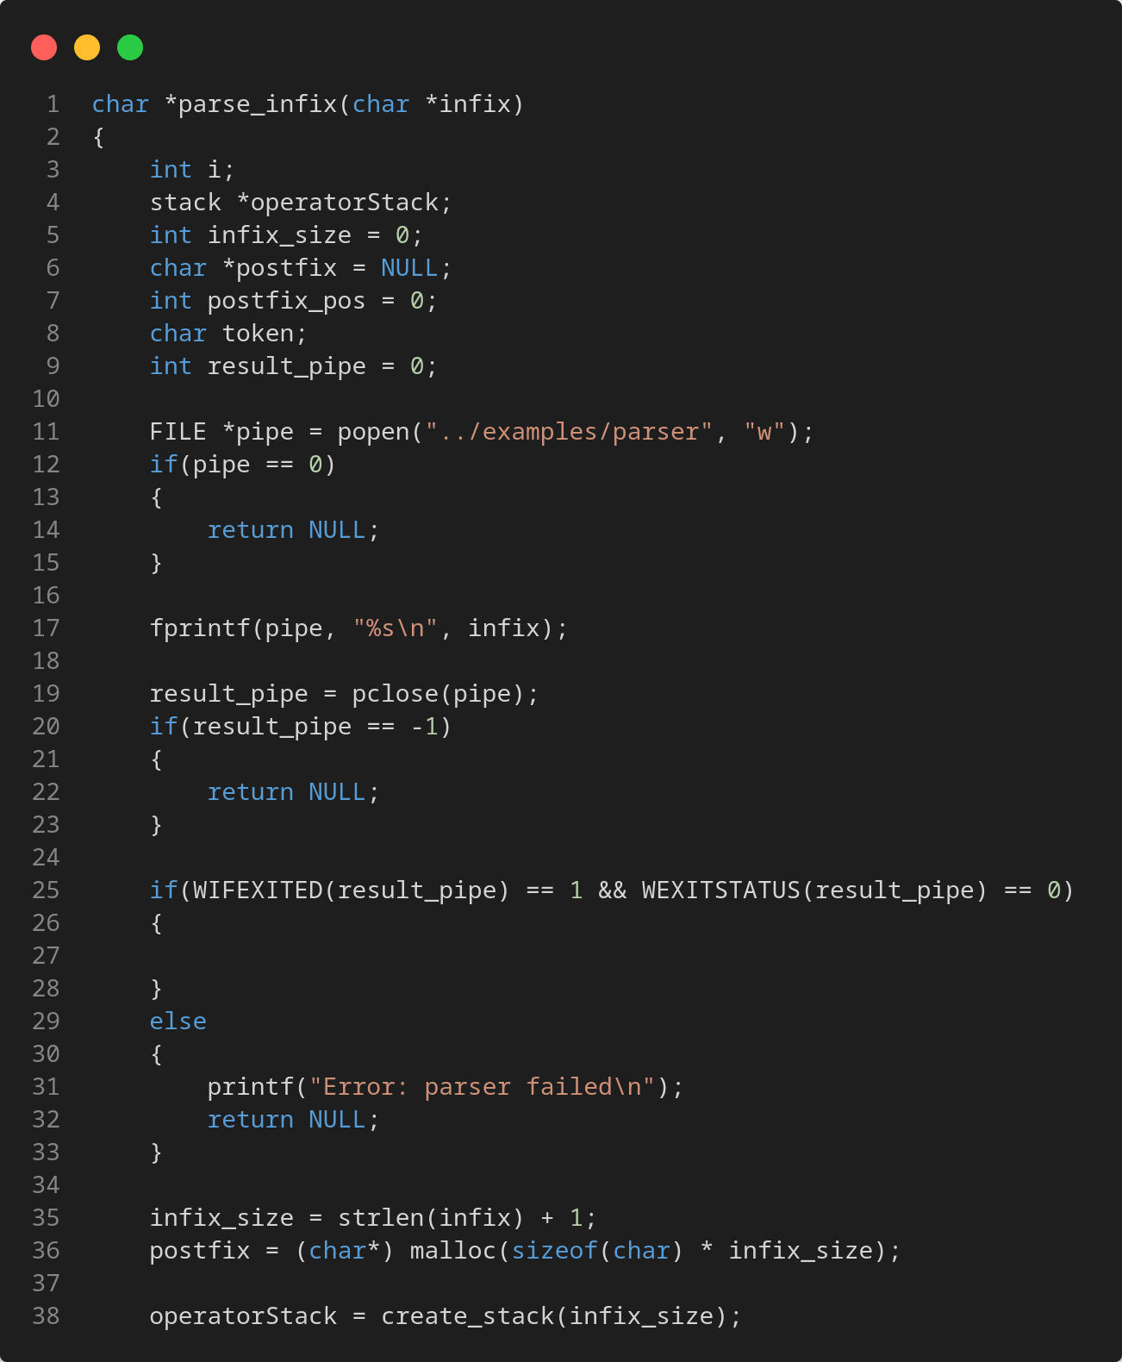
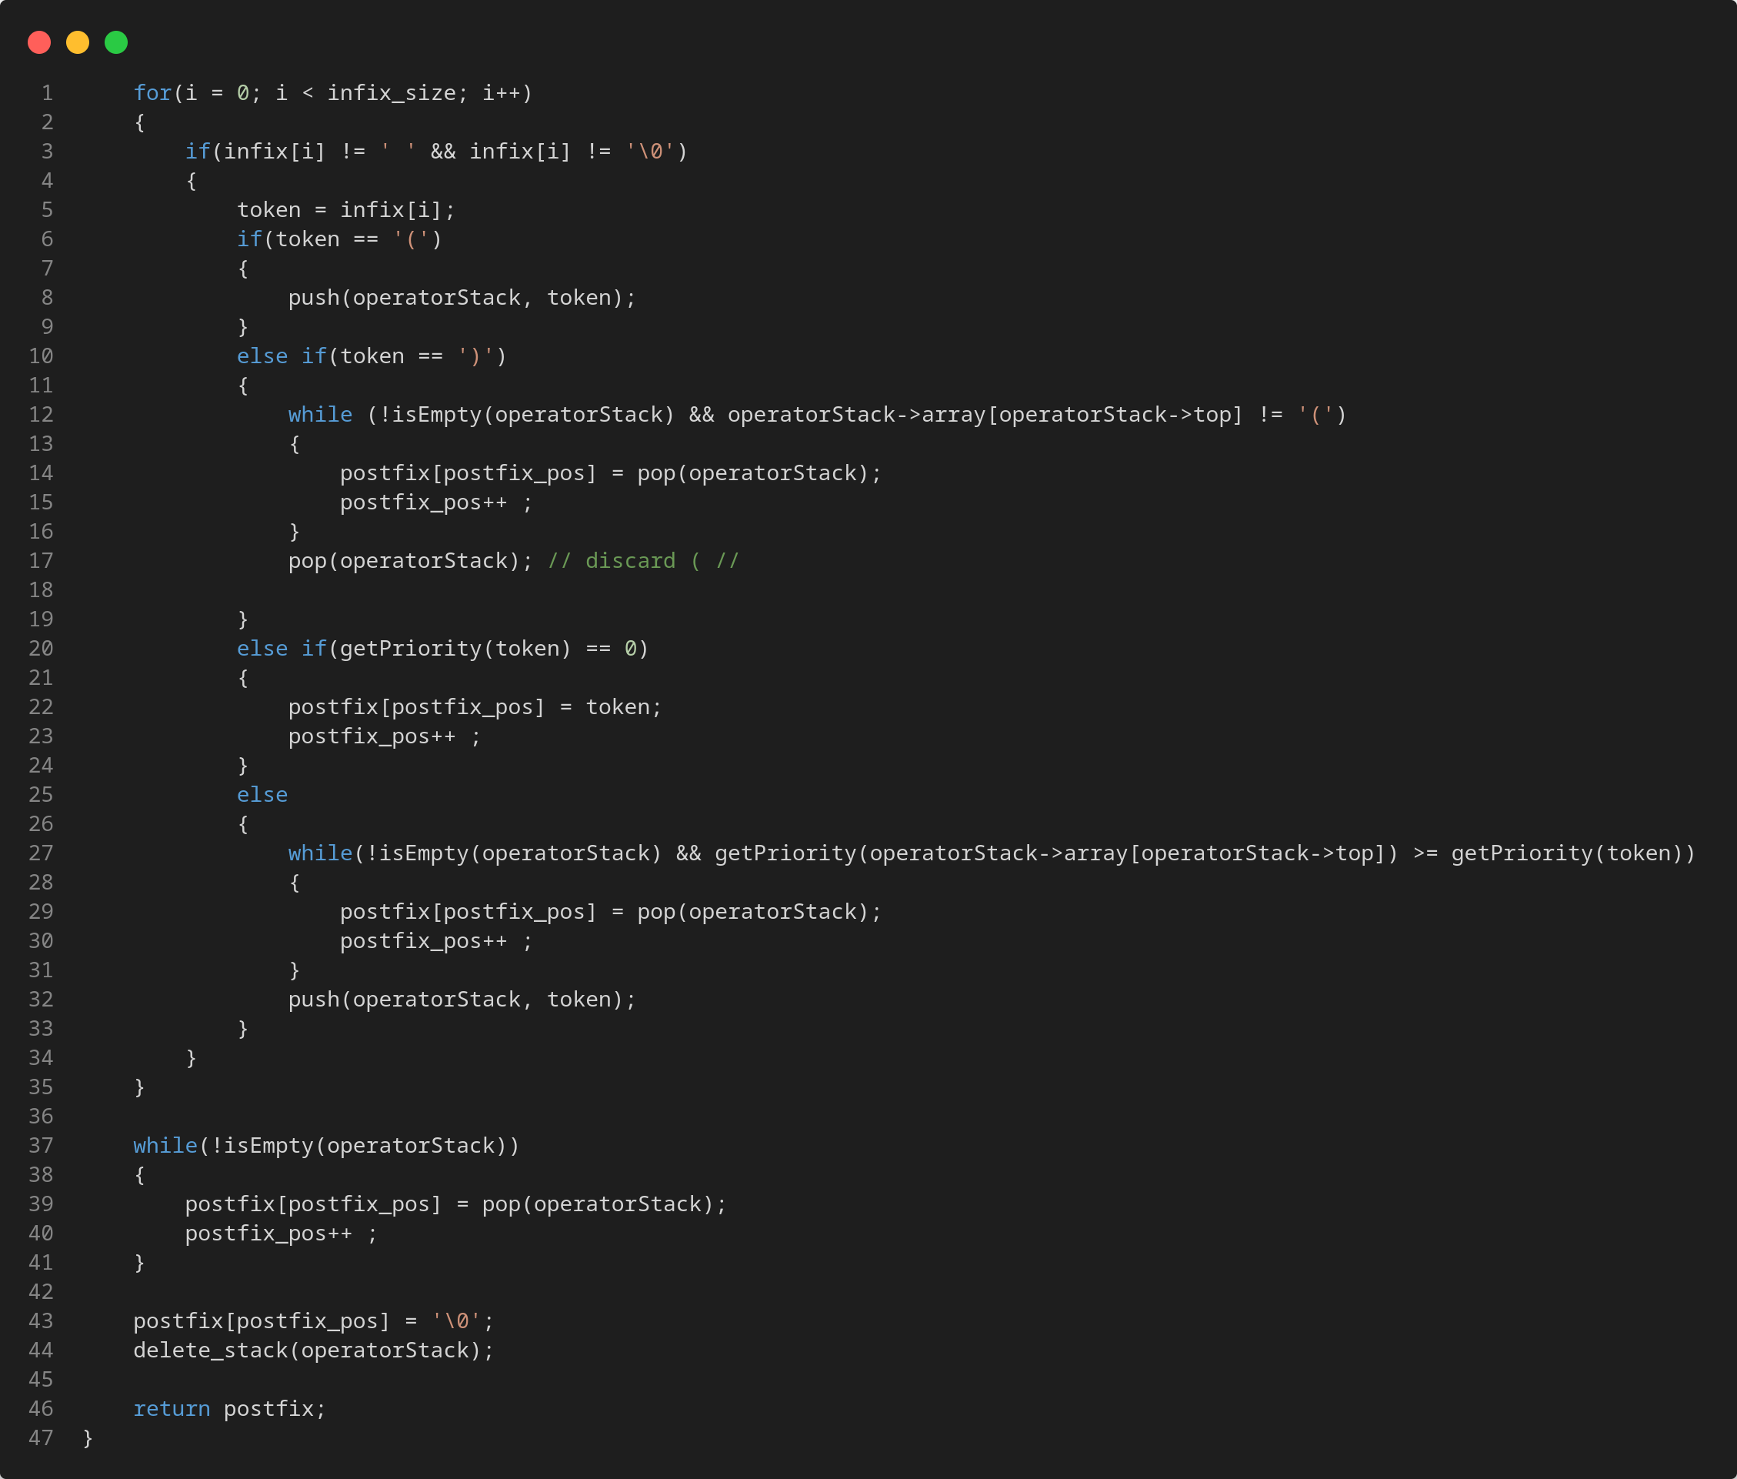
Convert Expression Code

Slide 10
Create BDD for an expression
Steps to create a BDD from Expression:
Convert infix to postfix
Keep array with variables Names (if a variable appears more than one time, just keep it once)
Keep size of this array
Add a sentinel "/" between variables in postfix expression and return it
Example:
Infix: A+B*C*(D+A)
Postfix: ABC*DA+*+
Postfix_new: A/B/C/*D/A/+*+

Slide 11
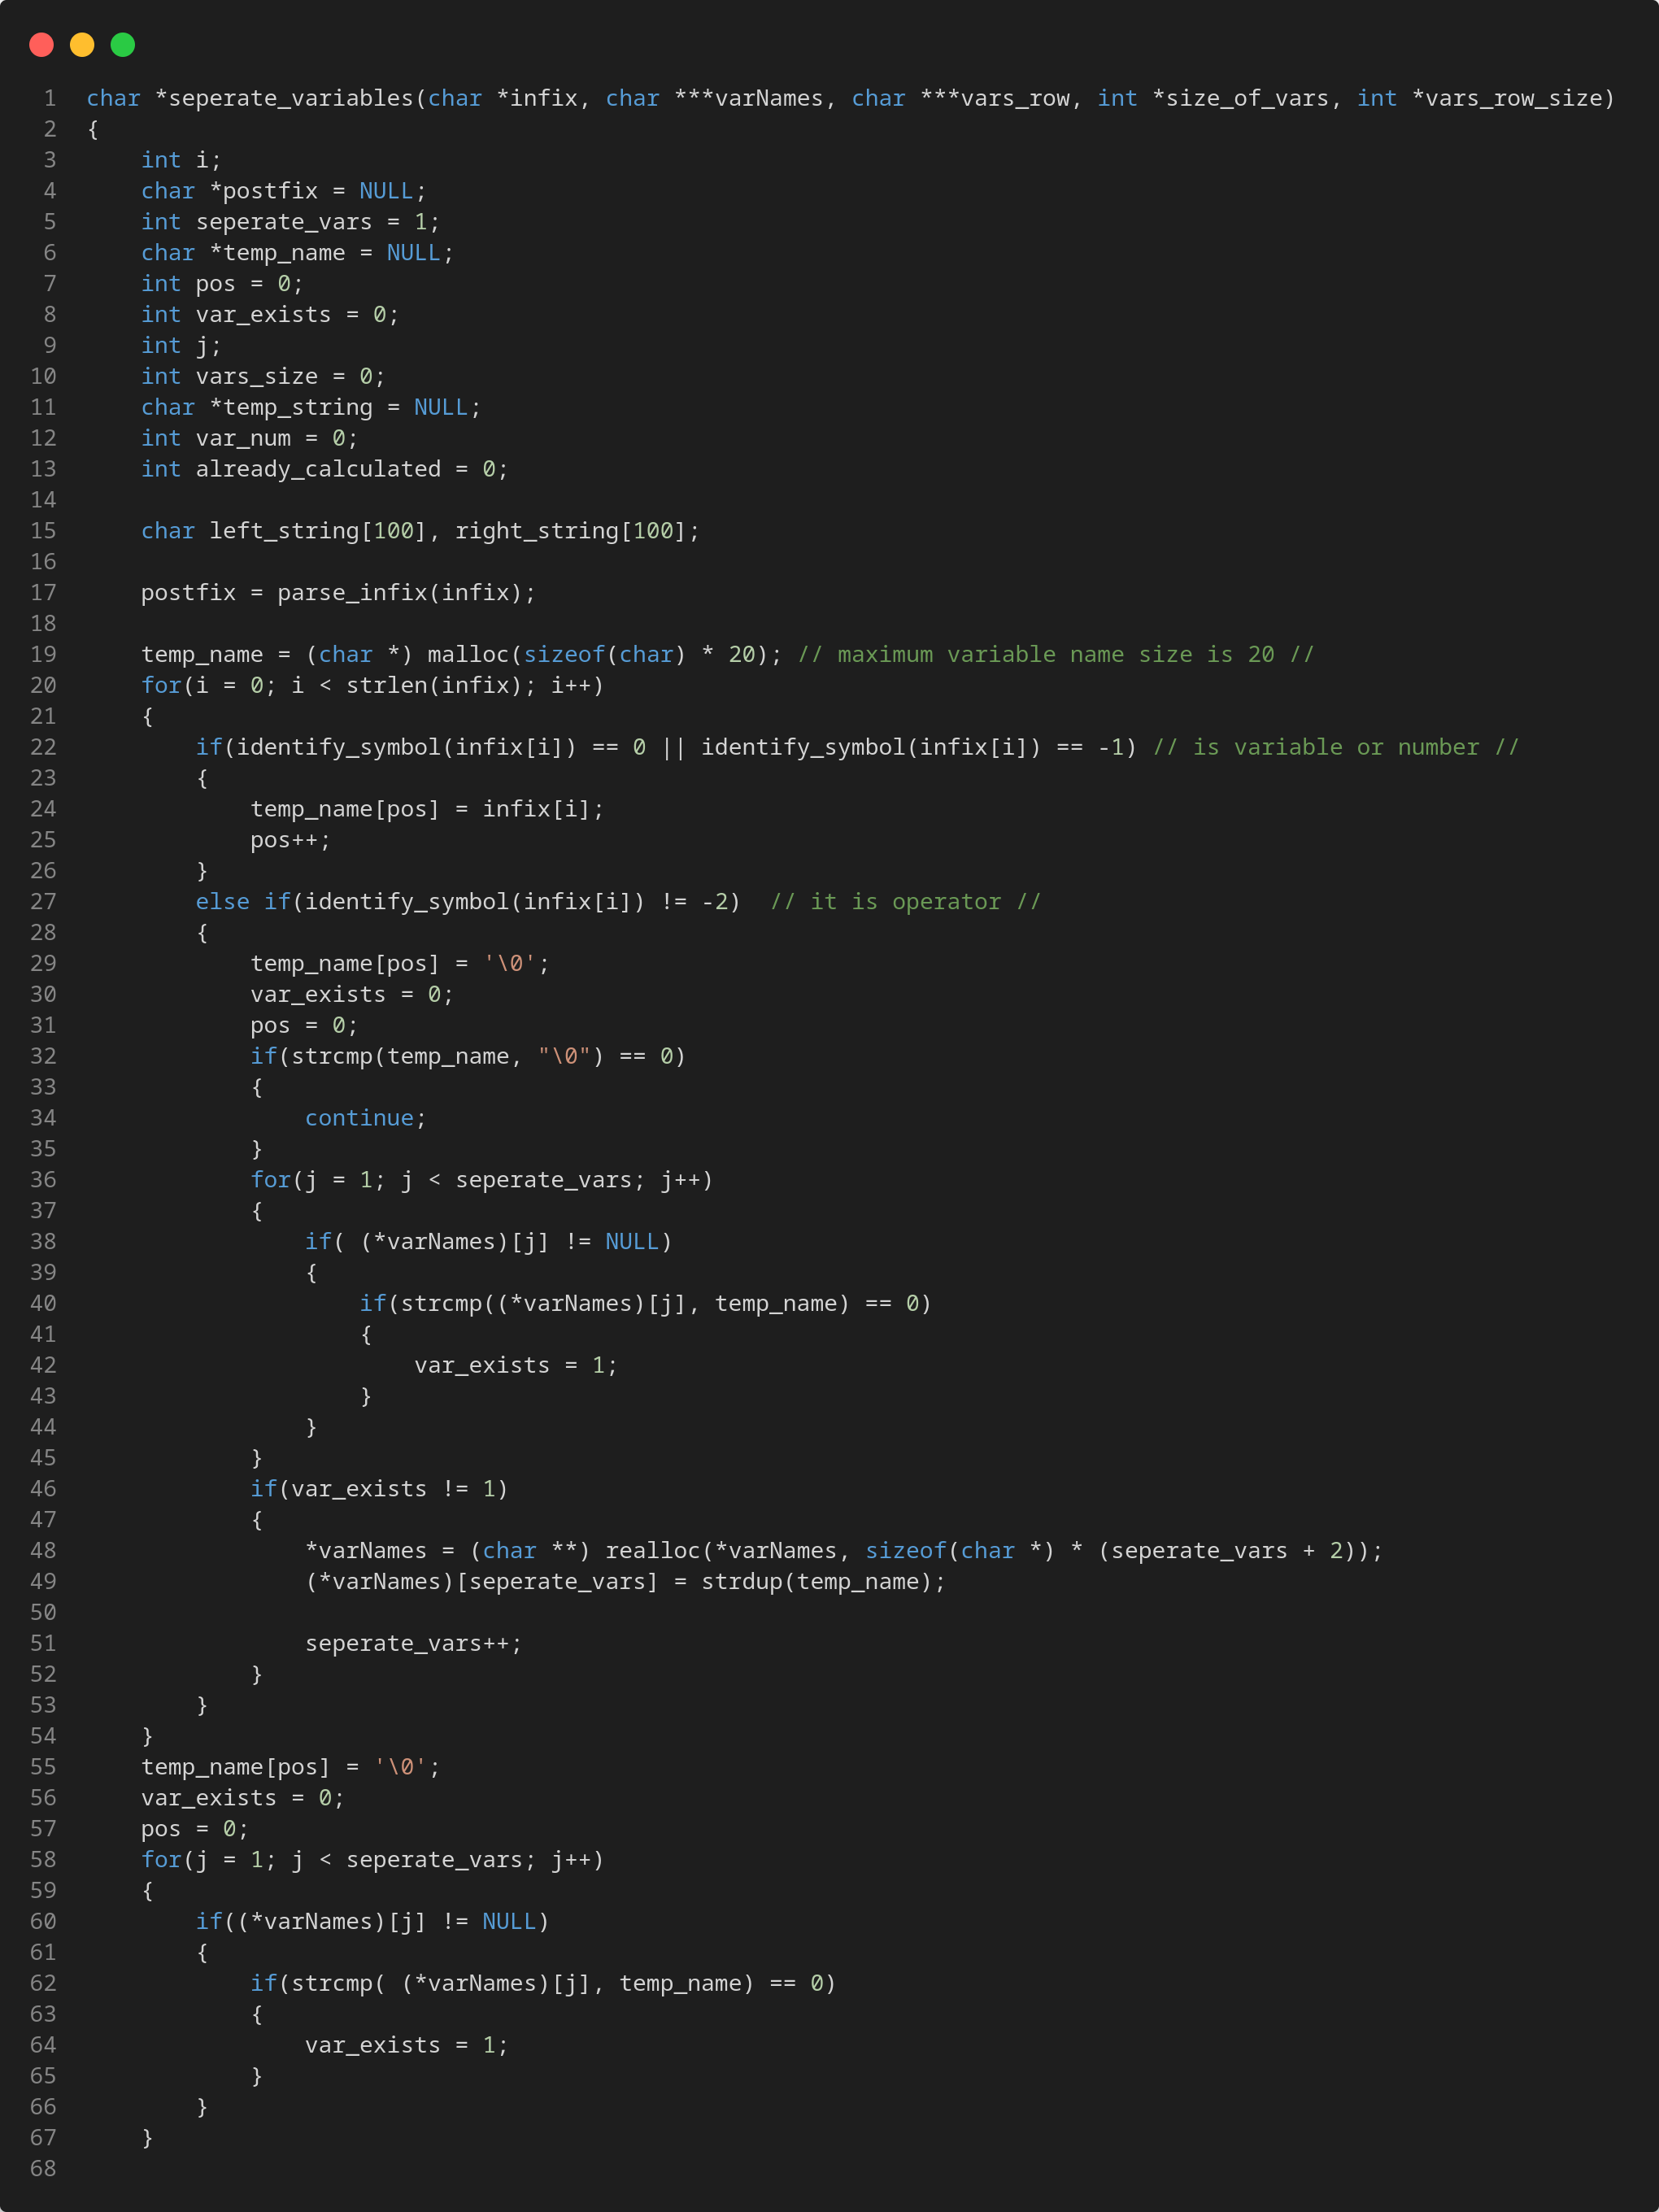
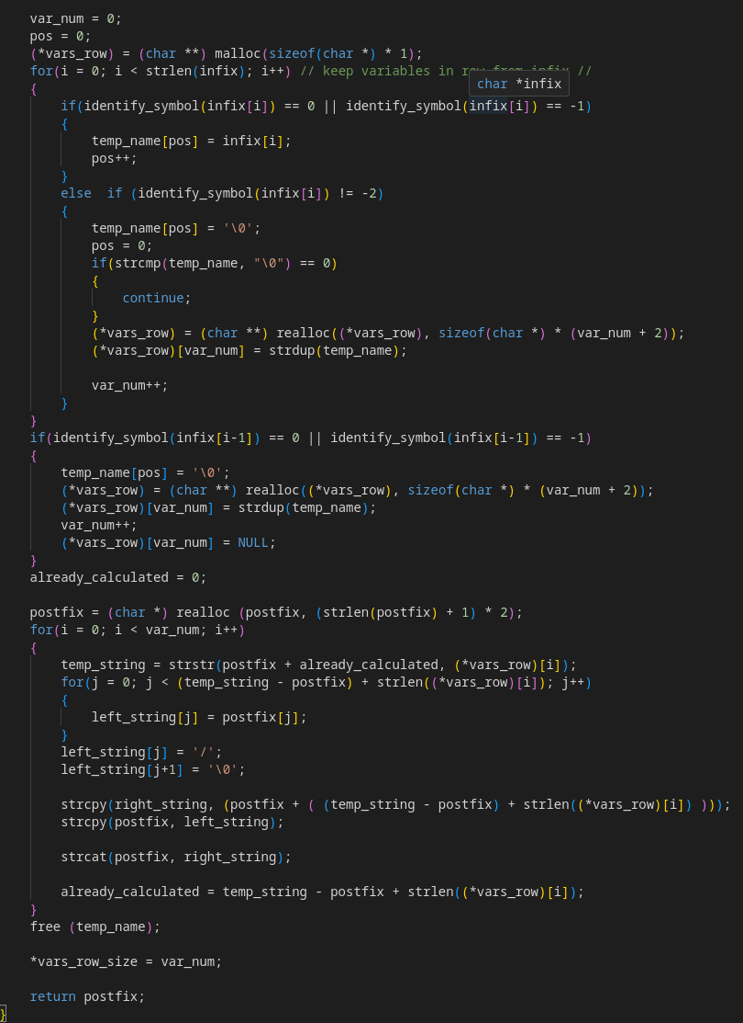
Create BDD for an expression

Slide 12
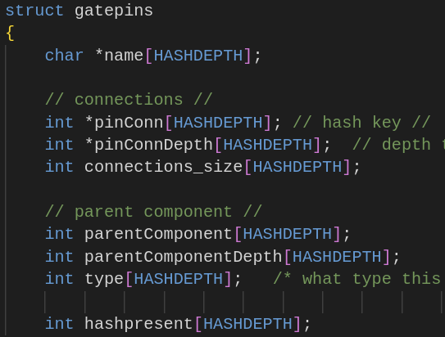
Gatepins Hashtable
gatepinhash:
Char *name[HASHDEPTH]: name of pin
Int *pinConn[HASHDEPTH]: array with hash values of successors of this pin
Int *pinConnDepth[HASHDEPTH]: array with hash depth of successors of this pin
Int connections_size[HASHDEPTH]: number of connections for each pin
Int parentComponent[HASHDEPTH]: hash value for component
Int parentComponentDepth[HASHDEPTH]: hash depth for component
Int type[HASHDEPTH]: Wire or IO
Int hashpresent[HASHDEPTH]: variable to show us if bucket is empty or not

Slide 13
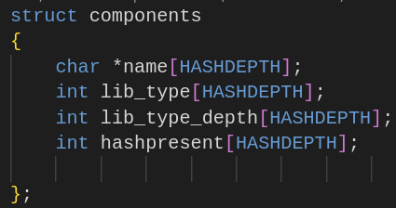
Components Hashtable
Comphash:
Char *name[HASHDEPTH]: name of component
Int lib_type[HASHDEPTH]: array with hash values of cell type
Int lib_type_depth[HASHDEPTH]: array with hash depth of cell type
Int hashpresent[HASHDEPTH]: variable to show us if bucket is empty or not

Slide 14
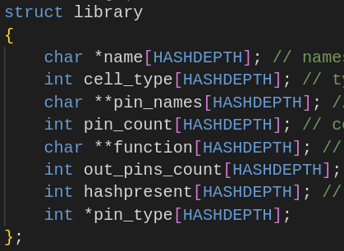
Library Hashtable
libhash:
Char *name[HASHDEPTH]: name of cell
Int cell_type[HASHDEPTH]: type of each cell (Combinational or Sequential)
Int *pin_names[HASHDEPTH]: names of pins for each cell
Int pin_count[HASHDEPTH]: number of pins current cell has
Char **function[HASHDEPTH]: boolean function for each cell (it can have more than one outputs)
Int out_pins_count[HASHDEPTH]: number of output pins
Int *pin_type[HASHDEPTH]: Input or Output
Int hashpresent[HASHDEPTH]: variable to show us if bucket is empty or not

Slide 15
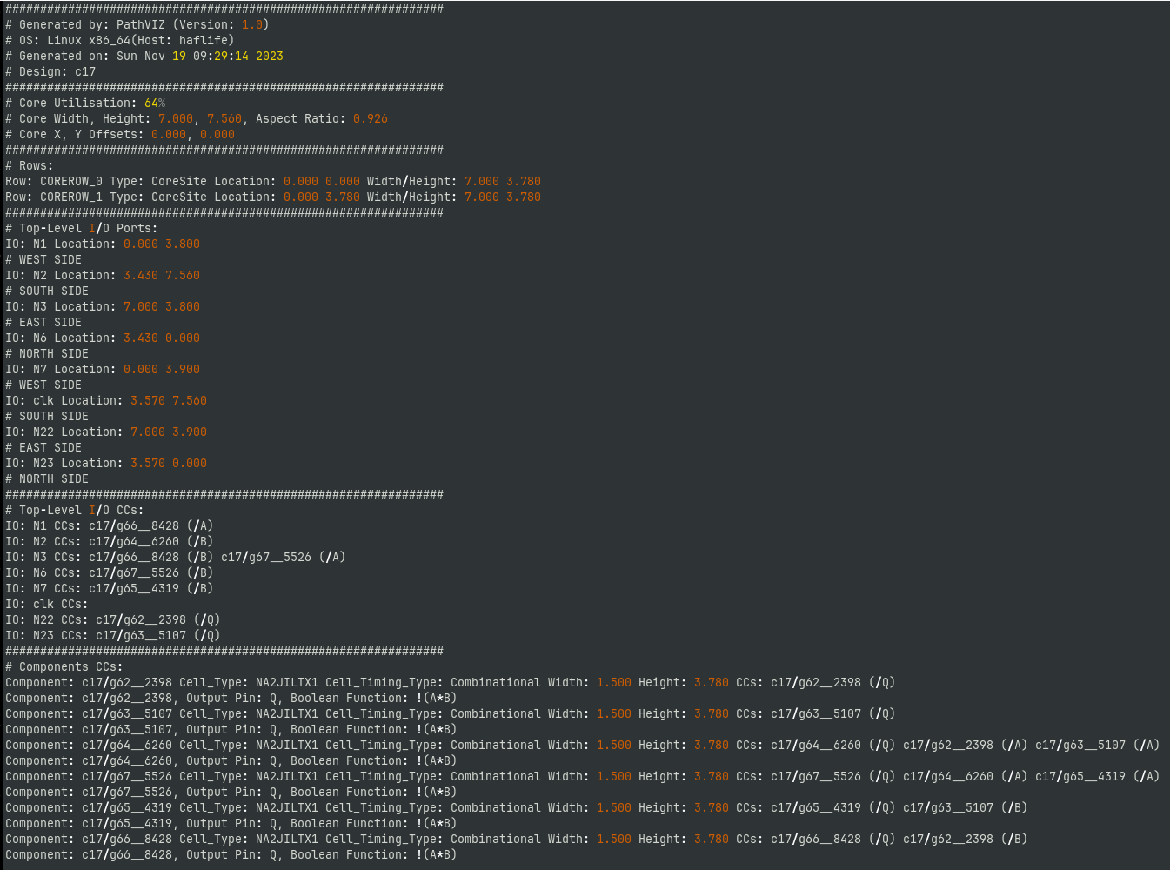
Parser
I split the file in 3 parts:
1st one has the names of IOs
2nd has the connections of each IO
3rd one contains all components cells and gatepins connections
1
2
3

Slide 16
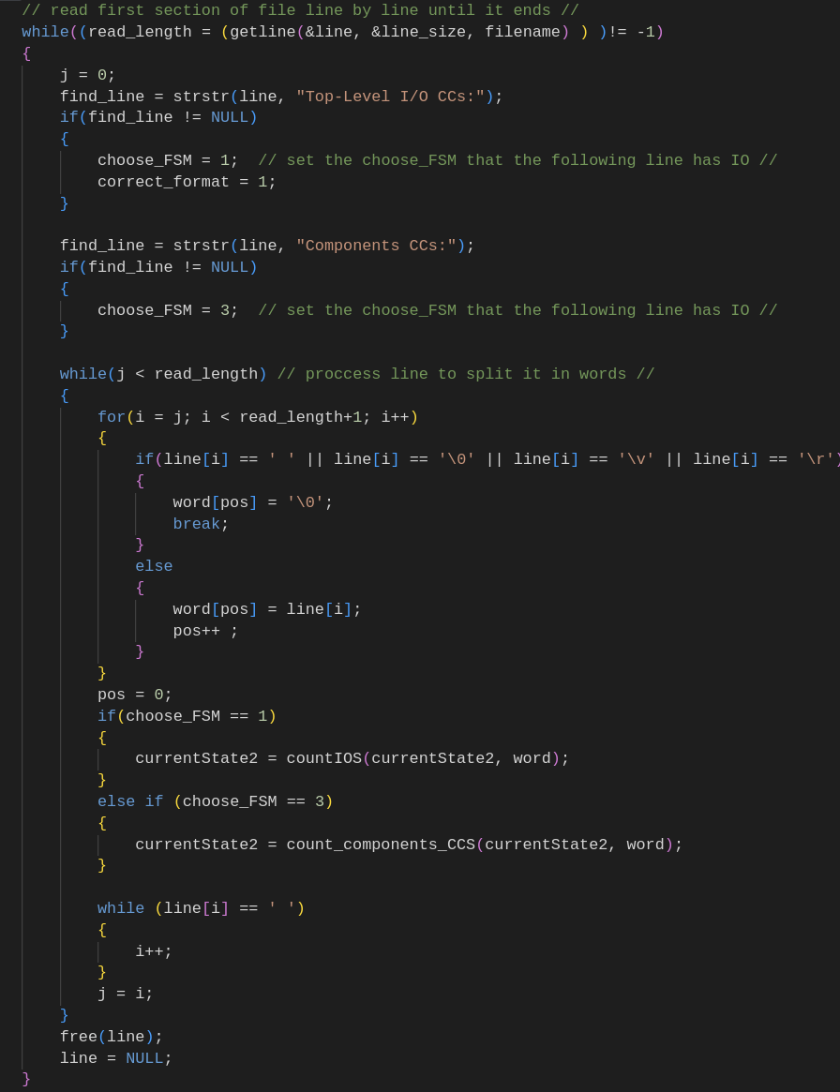
Parser
Parser reads file line by line and search for specific string that indicates a different part of file. Based on this sentence it chooses the corresponding FSM.
After this it splits the line into words and pass them to FSM

Slide 17
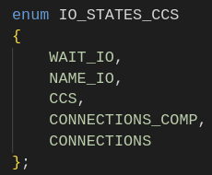
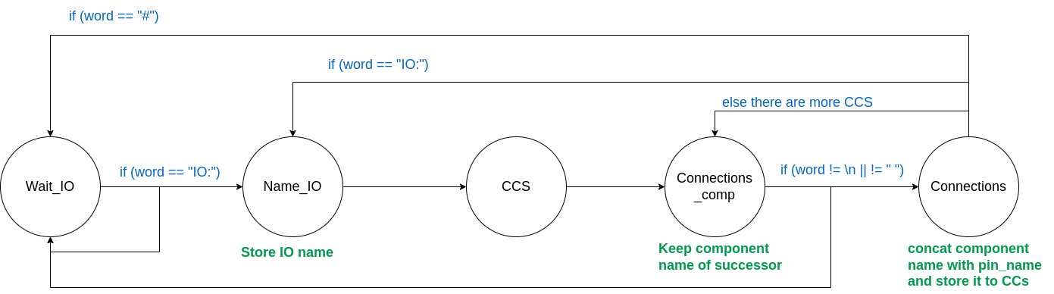
Parser
For all FSMs we use enums to be easier to read states
In first parse of file we count number of Components and Gateping we find to initialize the hashtables.
For cells we store them temporarily in a dynamic array and then find the exact number
Second parse: FSM that proccess IOS_CCs. It parses the 2nd part of file and store all IOs in gatepinhash and add all connections
Example: IO: o_wb_data|0 CCs: PID/U70 (/Q)
IO: o_un|31 CCs: PID/\un_reg[31] (/Q) PID/U830 (/IN0) PID/U1263 (/IN0)

Slide 18
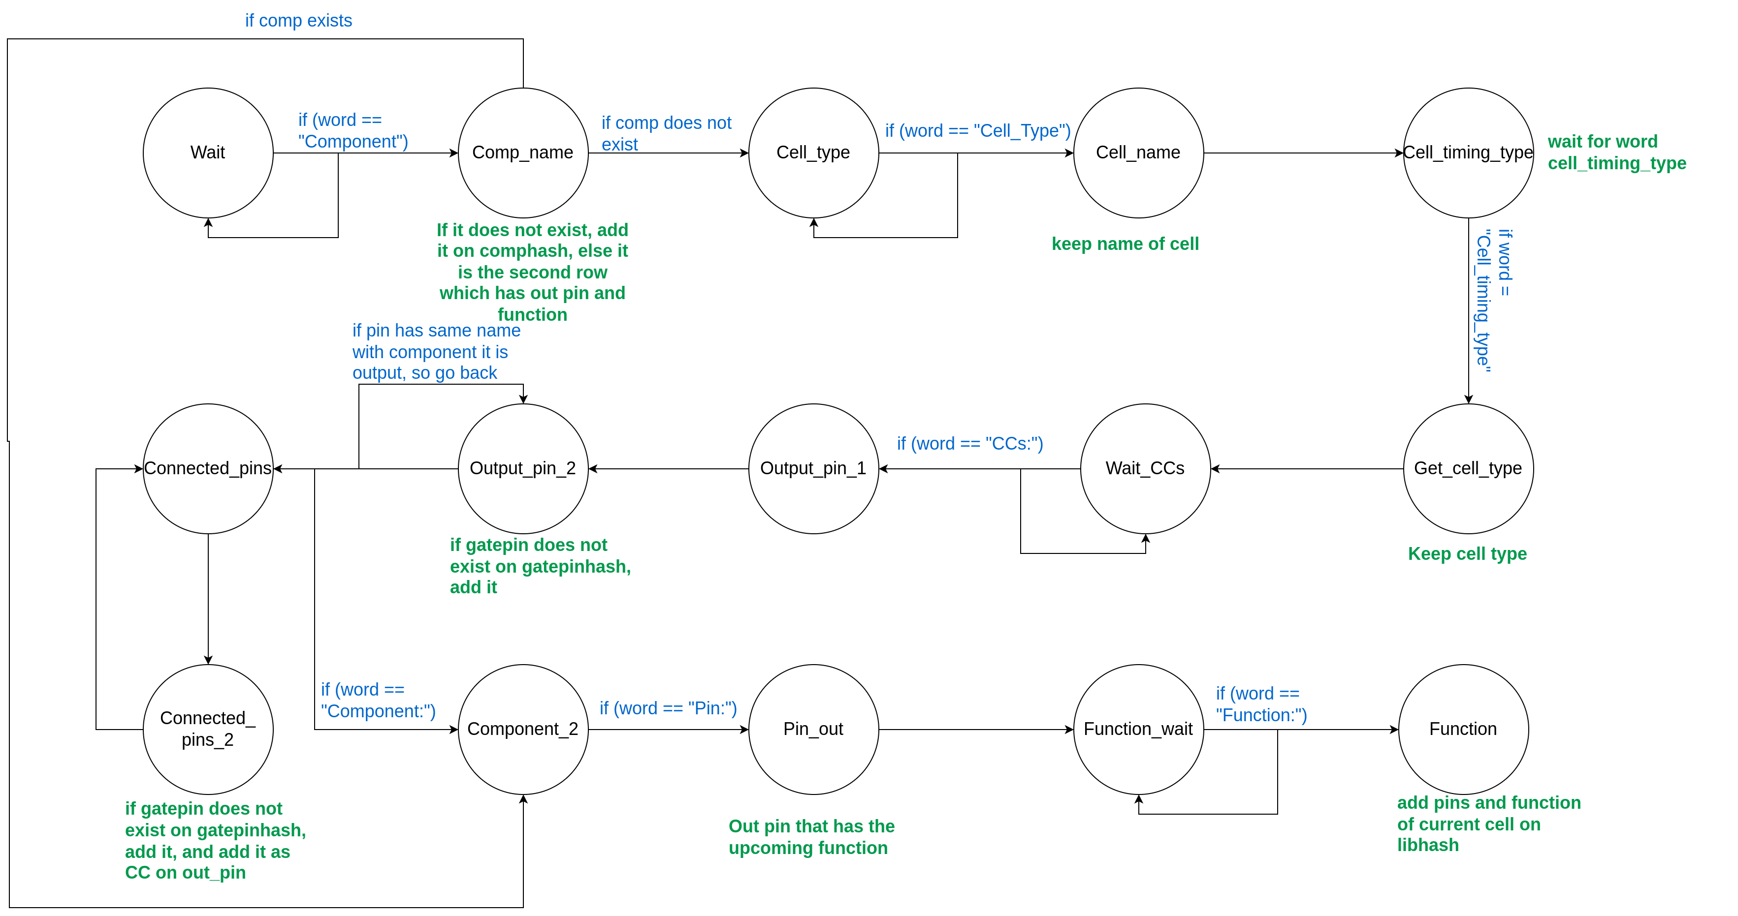
Second parse: FSM that proccess components cells and gatepins. It parses the 3rd part of file and store gatepins with connections, components with cell type and cells

Slide 19
Component: three_counters/U29 Cell_Type: add2d1 Cell_Timing_Type: Combinational Width: 15.120 Height: 8.400 CCs: three_counters/U29 (/CO) three_counters/U30 (/CI) three_counters/U29 (/SM) three_counters/U116 (/I1)
Component: three_counters/U29, Output Pin: CO, Boolean Function: (A*B)+(A*CI)+(B*CI)
Component: three_counters/U29, Output Pin: SM, Boolean Function: A^B^CI
Word: Component

Slide 20
Component: three_counters/U29 Cell_Type: add2d1 Cell_Timing_Type: Combinational Width: 15.120 Height: 8.400 CCs: three_counters/U29 (/CO) three_counters/U30 (/CI) three_counters/U29 (/SM) three_counters/U116 (/I1)
Component: three_counters/U29, Output Pin: CO, Boolean Function: (A*B)+(A*CI)+(B*CI)
Component: three_counters/U29, Output Pin: SM, Boolean Function: A^B^CI
Word: three_counters/U29
Comp_name

Slide 21
Component: three_counters/U29 Cell_Type: add2d1 Cell_Timing_Type: Combinational Width: 15.120 Height: 8.400 CCs: three_counters/U29 (/CO) three_counters/U30 (/CI) three_counters/U29 (/SM) three_counters/U116 (/I1)
Component: three_counters/U29, Output Pin: CO, Boolean Function: (A*B)+(A*CI)+(B*CI)
Component: three_counters/U29, Output Pin: SM, Boolean Function: A^B^CI
Word: Cell_Type
Comp_name

Slide 22
Component: three_counters/U29 Cell_Type: add2d1 Cell_Timing_Type: Combinational Width: 15.120 Height: 8.400 CCs: three_counters/U29 (/CO) three_counters/U30 (/CI) three_counters/U29 (/SM) three_counters/U116 (/I1)
Component: three_counters/U29, Output Pin: CO, Boolean Function: (A*B)+(A*CI)+(B*CI)
Component: three_counters/U29, Output Pin: SM, Boolean Function: A^B^CI
Word: add2d1
Comp_name
add2d1

Slide 23
Component: three_counters/U29 Cell_Type: add2d1 Cell_Timing_Type: Combinational Width: 15.120 Height: 8.400 CCs: three_counters/U29 (/CO) three_counters/U30 (/CI) three_counters/U29 (/SM) three_counters/U116 (/I1)
Component: three_counters/U29, Output Pin: CO, Boolean Function: (A*B)+(A*CI)+(B*CI)
Component: three_counters/U29, Output Pin: SM, Boolean Function: A^B^CI
Word: Cell_Timing_Type
Comp_name
add2d1

Slide 24
Component: three_counters/U29 Cell_Type: add2d1 Cell_Timing_Type: Combinational Width: 15.120 Height: 8.400 CCs: three_counters/U29 (/CO) three_counters/U30 (/CI) three_counters/U29 (/SM) three_counters/U116 (/I1)
Component: three_counters/U29, Output Pin: CO, Boolean Function: (A*B)+(A*CI)+(B*CI)
Component: three_counters/U29, Output Pin: SM, Boolean Function: A^B^CI
Word: Combinational
Comp_name
add2d1
Combinational

Slide 25
Component: three_counters/U29 Cell_Type: add2d1 Cell_Timing_Type: Combinational Width: 15.120 Height: 8.400 CCs: three_counters/U29 (/CO) three_counters/U30 (/CI) three_counters/U29 (/SM) three_counters/U116 (/I1)
Component: three_counters/U29, Output Pin: CO, Boolean Function: (A*B)+(A*CI)+(B*CI)
Component: three_counters/U29, Output Pin: SM, Boolean Function: A^B^CI
Word: Width
Comp_name
add2d1
Combinational

Slide 26
Component: three_counters/U29 Cell_Type: add2d1 Cell_Timing_Type: Combinational Width: 15.120 Height: 8.400 CCs: three_counters/U29 (/CO) three_counters/U30 (/CI) three_counters/U29 (/SM) three_counters/U116 (/I1)
Component: three_counters/U29, Output Pin: CO, Boolean Function: (A*B)+(A*CI)+(B*CI)
Component: three_counters/U29, Output Pin: SM, Boolean Function: A^B^CI
Word: CCs
Comp_name
add2d1
Combinational

Slide 27
Component: three_counters/U29 Cell_Type: add2d1 Cell_Timing_Type: Combinational Width: 15.120 Height: 8.400 CCs: three_counters/U29 (/CO) three_counters/U30 (/CI) three_counters/U29 (/SM) three_counters/U116 (/I1)
Component: three_counters/U29, Output Pin: CO, Boolean Function: (A*B)+(A*CI)+(B*CI)
Component: three_counters/U29, Output Pin: SM, Boolean Function: A^B^CI
Word: three_counters/U29
Comp_name
add2d1
Combinational
Three_counters/U29

Slide 28
Component: three_counters/U29 Cell_Type: add2d1 Cell_Timing_Type: Combinational Width: 15.120 Height: 8.400 CCs: three_counters/U29 (/CO) three_counters/U30 (/CI) three_counters/U29 (/SM) three_counters/U116 (/I1)
Component: three_counters/U29, Output Pin: CO, Boolean Function: (A*B)+(A*CI)+(B*CI)
Component: three_counters/U29, Output Pin: SM, Boolean Function: A^B^CI
Word: (/CO)
Comp_name
add2d1
Combinational
Three_counters/U29/CO

Slide 29

Component: three_counters/U29 Cell_Type: add2d1 Cell_Timing_Type: Combinational Width: 15.120 Height: 8.400 CCs: three_counters/U29 (/CO) three_counters/U30 (/CI) three_counters/U29 (/SM) three_counters/U116 (/I1)
Component: three_counters/U29, Output Pin: CO, Boolean Function: (A*B)+(A*CI)+(B*CI)
Component: three_counters/U29, Output Pin: SM, Boolean Function: A^B^CI
Word: (/CO)
Comp_name
add2d1
Combinational
Three_counters/U29/CO
Add gatepin to gatepinhash if it does not exists

Slide 30
Component: three_counters/U29 Cell_Type: add2d1 Cell_Timing_Type: Combinational Width: 15.120 Height: 8.400 CCs: three_counters/U29 (/CO) three_counters/U30 (/CI) three_counters/U29 (/SM) three_counters/U116 (/I1)
Component: three_counters/U29, Output Pin: CO, Boolean Function: (A*B)+(A*CI)+(B*CI)
Component: three_counters/U29, Output Pin: SM, Boolean Function: A^B^CI
Word: three_counters/U30
Comp_name
add2d1
Combinational
Three_counters/U29/CO
Three_counters/U30

Slide 31
Component: three_counters/U29 Cell_Type: add2d1 Cell_Timing_Type: Combinational Width: 15.120 Height: 8.400 CCs: three_counters/U29 (/CO) three_counters/U30 (/CI) three_counters/U29 (/SM) three_counters/U116 (/I1)
Component: three_counters/U29, Output Pin: CO, Boolean Function: (A*B)+(A*CI)+(B*CI)
Component: three_counters/U29, Output Pin: SM, Boolean Function: A^B^CI
Word: (/CI)
Comp_name
add2d1
Combinational
Three_counters/U29/CO
Three_counters/U30/CI

Slide 32
Component: three_counters/U29 Cell_Type: add2d1 Cell_Timing_Type: Combinational Width: 15.120 Height: 8.400 CCs: three_counters/U29 (/CO) three_counters/U30 (/CI) three_counters/U29 (/SM) three_counters/U116 (/I1)
Component: three_counters/U29, Output Pin: CO, Boolean Function: (A*B)+(A*CI)+(B*CI)
Component: three_counters/U29, Output Pin: SM, Boolean Function: A^B^CI
Word: (/CI)
Comp_name
add2d1
Combinational
Three_counters/U29/CO
Three_counters/U30/CI
Add gatepin to gatepinhash if it does not exists
Add gatepin to CCs of Three_counters/U29/CO

Slide 33
Component: three_counters/U29 Cell_Type: add2d1 Cell_Timing_Type: Combinational Width: 15.120 Height: 8.400 CCs: three_counters/U29 (/CO) three_counters/U30 (/CI) three_counters/U29 (/SM) three_counters/U116 (/I1)
Component: three_counters/U29, Output Pin: CO, Boolean Function: (A*B)+(A*CI)+(B*CI)
Component: three_counters/U29, Output Pin: SM, Boolean Function: A^B^CI
Word: three_counters/U29
Comp_name
add2d1
Combinational
Three_counters/U29/CO
Three_counters/U30/CI
Three_counters/U29

Slide 34
Component: three_counters/U29 Cell_Type: add2d1 Cell_Timing_Type: Combinational Width: 15.120 Height: 8.400 CCs: three_counters/U29 (/CO) three_counters/U30 (/CI) three_counters/U29 (/SM) three_counters/U116 (/I1)
Component: three_counters/U29, Output Pin: CO, Boolean Function: (A*B)+(A*CI)+(B*CI)
Component: three_counters/U29, Output Pin: SM, Boolean Function: A^B^CI
Word: (/SM)
Comp_name
add2d1
Combinational
Three_counters/U29/CO
Three_counters/U30/CI
Three_counters/U29/SM

Slide 35
Component: three_counters/U29 Cell_Type: add2d1 Cell_Timing_Type: Combinational Width: 15.120 Height: 8.400 CCs: three_counters/U29 (/CO) three_counters/U30 (/CI) three_counters/U29 (/SM) three_counters/U116 (/I1)
Component: three_counters/U29, Output Pin: CO, Boolean Function: (A*B)+(A*CI)+(B*CI)
Component: three_counters/U29, Output Pin: SM, Boolean Function: A^B^CI
Word: (/SM)
Comp_name
add2d1
Combinational
Three_counters/U29/CO
Three_counters/U30/CI
Three_counters/U29/SM
Add three_counters/U29/SM to gatepinhash if it does not exists

Slide 36
Component: three_counters/U29 Cell_Type: add2d1 Cell_Timing_Type: Combinational Width: 15.120 Height: 8.400 CCs: three_counters/U29 (/CO) three_counters/U30 (/CI) three_counters/U29 (/SM) three_counters/U116 (/I1)
Component: three_counters/U29, Output Pin: CO, Boolean Function: (A*B)+(A*CI)+(B*CI)
Component: three_counters/U29, Output Pin: SM, Boolean Function: A^B^CI
Word: three_counters/U116
Comp_name
add2d1
Combinational
Three_counters/U29/CO
Three_counters/U30/CI
Three_counters/U29/SM
Three_counters/U116

Slide 37
Component: three_counters/U29 Cell_Type: add2d1 Cell_Timing_Type: Combinational Width: 15.120 Height: 8.400 CCs: three_counters/U29 (/CO) three_counters/U30 (/CI) three_counters/U29 (/SM) three_counters/U116 (/I1)
Component: three_counters/U29, Output Pin: CO, Boolean Function: (A*B)+(A*CI)+(B*CI)
Component: three_counters/U29, Output Pin: SM, Boolean Function: A^B^CI
Word: (/I1)
Comp_name
add2d1
Combinational
Three_counters/U29/CO
Three_counters/U30/CI
Three_counters/U29/SM
Three_counters/U116/I1
Add gatepin to gatepinhash if it does not exists
Add gatepin to CCs of Three_counters/U29/SM

Slide 38
Component: three_counters/U29 Cell_Type: add2d1 Cell_Timing_Type: Combinational Width: 15.120 Height: 8.400 CCs: three_counters/U29 (/CO) three_counters/U30 (/CI) three_counters/U29 (/SM) three_counters/U116 (/I1)
Component: three_counters/U29, Output Pin: CO, Boolean Function: (A*B)+(A*CI)+(B*CI)
Component: three_counters/U29, Output Pin: SM, Boolean Function: A^B^CI
Word: Component
Comp_name
add2d1
Combinational
Three_counters/U29/CO
Three_counters/U30/CI
Three_counters/U29/SM
Three_counters/U116/I1

Slide 39
Component: three_counters/U29 Cell_Type: add2d1 Cell_Timing_Type: Combinational Width: 15.120 Height: 8.400 CCs: three_counters/U29 (/CO) three_counters/U30 (/CI) three_counters/U29 (/SM) three_counters/U116 (/I1)
Component: three_counters/U29, Output Pin: CO, Boolean Function: (A*B)+(A*CI)+(B*CI)
Component: three_counters/U29, Output Pin: SM, Boolean Function: A^B^CI
Word: three_counters/U29,
Comp_name
add2d1
Combinational
Three_counters/U29/CO
Three_counters/U30/CI
Three_counters/U29/SM
Three_counters/U116/I1

Slide 40
Component: three_counters/U29 Cell_Type: add2d1 Cell_Timing_Type: Combinational Width: 15.120 Height: 8.400 CCs: three_counters/U29 (/CO) three_counters/U30 (/CI) three_counters/U29 (/SM) three_counters/U116 (/I1)
Component: three_counters/U29, Output Pin: CO, Boolean Function: (A*B)+(A*CI)+(B*CI)
Component: three_counters/U29, Output Pin: SM, Boolean Function: A^B^CI
Word: Output
Comp_name
add2d1
Combinational
Three_counters/U29/CO
Three_counters/U30/CI
Three_counters/U29/SM
Three_counters/U116/I1

Slide 41
Component: three_counters/U29 Cell_Type: add2d1 Cell_Timing_Type: Combinational Width: 15.120 Height: 8.400 CCs: three_counters/U29 (/CO) three_counters/U30 (/CI) three_counters/U29 (/SM) three_counters/U116 (/I1)
Component: three_counters/U29, Output Pin: CO, Boolean Function: (A*B)+(A*CI)+(B*CI)
Component: three_counters/U29, Output Pin: SM, Boolean Function: A^B^CI
Word: Pin:
Comp_name
add2d1
Combinational
Three_counters/U29/CO
Three_counters/U30/CI
Three_counters/U29/SM
Three_counters/U116/I1

Slide 42
Component: three_counters/U29 Cell_Type: add2d1 Cell_Timing_Type: Combinational Width: 15.120 Height: 8.400 CCs: three_counters/U29 (/CO) three_counters/U30 (/CI) three_counters/U29 (/SM) three_counters/U116 (/I1)
Component: three_counters/U29, Output Pin: CO, Boolean Function: (A*B)+(A*CI)+(B*CI)
Component: three_counters/U29, Output Pin: SM, Boolean Function: A^B^CI
Word: CO,
Comp_name
add2d1
Combinational
Three_counters/U29/CO
Three_counters/U30/CI
Three_counters/U29/SM
Three_counters/U116/I1
Cell_pin

Slide 43
Component: three_counters/U29 Cell_Type: add2d1 Cell_Timing_Type: Combinational Width: 15.120 Height: 8.400 CCs: three_counters/U29 (/CO) three_counters/U30 (/CI) three_counters/U29 (/SM) three_counters/U116 (/I1)
Component: three_counters/U29, Output Pin: CO, Boolean Function: (A*B)+(A*CI)+(B*CI)
Component: three_counters/U29, Output Pin: SM, Boolean Function: A^B^CI
Word: Boolean
Comp_name
add2d1
Combinational
Three_counters/U29/CO
Three_counters/U30/CI
Three_counters/U29/SM
Three_counters/U116/I1
Cell_pin

Slide 44
Component: three_counters/U29 Cell_Type: add2d1 Cell_Timing_Type: Combinational Width: 15.120 Height: 8.400 CCs: three_counters/U29 (/CO) three_counters/U30 (/CI) three_counters/U29 (/SM) three_counters/U116 (/I1)
Component: three_counters/U29, Output Pin: CO, Boolean Function: (A*B)+(A*CI)+(B*CI)
Component: three_counters/U29, Output Pin: SM, Boolean Function: A^B^CI
Word: Function
Comp_name
add2d1
Combinational
Three_counters/U29/CO
Three_counters/U30/CI
Three_counters/U29/SM
Three_counters/U116/I1
Cell_pin

Slide 45
Component: three_counters/U29 Cell_Type: add2d1 Cell_Timing_Type: Combinational Width: 15.120 Height: 8.400 CCs: three_counters/U29 (/CO) three_counters/U30 (/CI) three_counters/U29 (/SM) three_counters/U116 (/I1)
Component: three_counters/U29, Output Pin: CO, Boolean Function: (A*B)+(A*CI)+(B*CI)
Component: three_counters/U29, Output Pin: SM, Boolean Function: A^B^CI
Word: (A*B)+(A*CI)+(B*CI)
Comp_name
add2d1
Combinational
Three_counters/U29/CO
Three_counters/U30/CI
Three_counters/U29/SM
Three_counters/U116/I1
Cell_pin
(A*B)+(A*CI)+(B*CI)

Slide 46
Component: three_counters/U29 Cell_Type: add2d1 Cell_Timing_Type: Combinational Width: 15.120 Height: 8.400 CCs: three_counters/U29 (/CO) three_counters/U30 (/CI) three_counters/U29 (/SM) three_counters/U116 (/I1)
Component: three_counters/U29, Output Pin: CO, Boolean Function: (A*B)+(A*CI)+(B*CI)
Component: three_counters/U29, Output Pin: SM, Boolean Function: A^B^CI
Word: (A*B)+(A*CI)+(B*CI)
Comp_name
add2d1
Combinational
Three_counters/U29/CO
Three_counters/U30/CI
Three_counters/U29/SM
Three_counters/U116/I1
Cell_pin
(A*B)+(A*CI)+(B*CI)
Add on hashtables component and cell with all information

Slide 47
Component: three_counters/U29 Cell_Type: add2d1 Cell_Timing_Type: Combinational Width: 15.120 Height: 8.400 CCs: three_counters/U29 (/CO) three_counters/U30 (/CI) three_counters/U29 (/SM) three_counters/U116 (/I1)
Component: three_counters/U29, Output Pin: CO, Boolean Function: (A*B)+(A*CI)+(B*CI)
Component: three_counters/U29, Output Pin: SM, Boolean Function: A^B^CI
Word: Component:
Comp_name
add2d1
Combinational
Three_counters/U29/CO
Three_counters/U30/CI
Three_counters/U29/SM
Three_counters/U116/I1
Cell_pin
(A*B)+(A*CI)+(B*CI)

Slide 48
Component: three_counters/U29 Cell_Type: add2d1 Cell_Timing_Type: Combinational Width: 15.120 Height: 8.400 CCs: three_counters/U29 (/CO) three_counters/U30 (/CI) three_counters/U29 (/SM) three_counters/U116 (/I1)
Component: three_counters/U29, Output Pin: CO, Boolean Function: (A*B)+(A*CI)+(B*CI)
Component: three_counters/U29, Output Pin: SM, Boolean Function: A^B^CI
Word: three_counters/U29,
Already exists
Comp_name
add2d1
Combinational
Three_counters/U29/CO
Three_counters/U30/CI
Three_counters/U29/SM
Three_counters/U116/I1
Cell_pin
(A*B)+(A*CI)+(B*CI)

Slide 49
Component: three_counters/U29 Cell_Type: add2d1 Cell_Timing_Type: Combinational Width: 15.120 Height: 8.400 CCs: three_counters/U29 (/CO) three_counters/U30 (/CI) three_counters/U29 (/SM) three_counters/U116 (/I1)
Component: three_counters/U29, Output Pin: CO, Boolean Function: (A*B)+(A*CI)+(B*CI)
Component: three_counters/U29, Output Pin: SM, Boolean Function: A^B^CI
Word: Output
Comp_name
add2d1
Combinational
Three_counters/U29/CO
Three_counters/U30/CI
Three_counters/U29/SM
Three_counters/U116/I1
Cell_pin
(A*B)+(A*CI)+(B*CI)

Slide 50
Component: three_counters/U29 Cell_Type: add2d1 Cell_Timing_Type: Combinational Width: 15.120 Height: 8.400 CCs: three_counters/U29 (/CO) three_counters/U30 (/CI) three_counters/U29 (/SM) three_counters/U116 (/I1)
Component: three_counters/U29, Output Pin: CO, Boolean Function: (A*B)+(A*CI)+(B*CI)
Component: three_counters/U29, Output Pin: SM, Boolean Function: A^B^CI
Word: Pin:
Comp_name
add2d1
Combinational
Three_counters/U29/CO
Three_counters/U30/CI
Three_counters/U29/SM
Three_counters/U116/I1
Cell_pin
(A*B)+(A*CI)+(B*CI)

Slide 51
Component: three_counters/U29 Cell_Type: add2d1 Cell_Timing_Type: Combinational Width: 15.120 Height: 8.400 CCs: three_counters/U29 (/CO) three_counters/U30 (/CI) three_counters/U29 (/SM) three_counters/U116 (/I1)
Component: three_counters/U29, Output Pin: CO, Boolean Function: (A*B)+(A*CI)+(B*CI)
Component: three_counters/U29, Output Pin: SM, Boolean Function: A^B^CI
Word: SM,
Comp_name
add2d1
Combinational
Three_counters/U29/CO
Three_counters/U30/CI
Three_counters/U29/SM
Three_counters/U116/I1
Cell_pin (SM)
(A*B)+(A*CI)+(B*CI)

Slide 52
Component: three_counters/U29 Cell_Type: add2d1 Cell_Timing_Type: Combinational Width: 15.120 Height: 8.400 CCs: three_counters/U29 (/CO) three_counters/U30 (/CI) three_counters/U29 (/SM) three_counters/U116 (/I1)
Component: three_counters/U29, Output Pin: CO, Boolean Function: (A*B)+(A*CI)+(B*CI)
Component: three_counters/U29, Output Pin: SM, Boolean Function: A^B^CI
Word: Function
Comp_name
add2d1
Combinational
Three_counters/U29/CO
Three_counters/U30/CI
Three_counters/U29/SM
Three_counters/U116/I1
Cell_pin (SM)
(A*B)+(A*CI)+(B*CI)

Slide 53
Component: three_counters/U29 Cell_Type: add2d1 Cell_Timing_Type: Combinational Width: 15.120 Height: 8.400 CCs: three_counters/U29 (/CO) three_counters/U30 (/CI) three_counters/U29 (/SM) three_counters/U116 (/I1)
Component: three_counters/U29, Output Pin: CO, Boolean Function: (A*B)+(A*CI)+(B*CI)
Component: three_counters/U29, Output Pin: SM, Boolean Function: A^B^CI
Word: A^B^CI
Comp_name
add2d1
Combinational
Three_counters/U29/CO
Three_counters/U30/CI
Three_counters/U29/SM
Three_counters/U116/I1
Cell_pin (SM)
A^B^CI

Slide 54
Component: three_counters/U29 Cell_Type: add2d1 Cell_Timing_Type: Combinational Width: 15.120 Height: 8.400 CCs: three_counters/U29 (/CO) three_counters/U30 (/CI) three_counters/U29 (/SM) three_counters/U116 (/I1)
Component: three_counters/U29, Output Pin: CO, Boolean Function: (A*B)+(A*CI)+(B*CI)
Component: three_counters/U29, Output Pin: SM, Boolean Function: A^B^CI
Word: A^B^CI
Comp_name
add2d1
Combinational
Three_counters/U29/CO
Three_counters/U30/CI
Three_counters/U29/SM
Three_counters/U116/I1
Cell_pin (SM)
A^B^CI
Add on hashtables cell with all informations

Slide 55
Component: three_counters/U29 Cell_Type: add2d1 Cell_Timing_Type: Combinational Width: 15.120 Height: 8.400 CCs: three_counters/U29 (/CO) three_counters/U30 (/CI) three_counters/U29 (/SM) three_counters/U116 (/I1)
Component: three_counters/U29, Output Pin: CO, Boolean Function: (A*B)+(A*CI)+(B*CI)
Component: three_counters/U29, Output Pin: SM, Boolean Function: A^B^CI
END
Comp_name
add2d1
Combinational
Three_counters/U29/CO
Three_counters/U30/CI
Three_counters/U29/SM
Three_counters/U116/I1
Cell_pin (SM)
A^B^CI

Slide 56
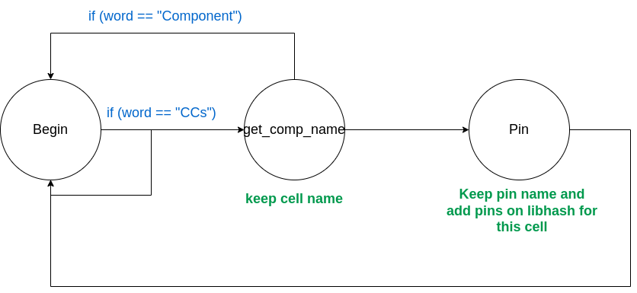
Third parse: FSM that proccess 3rd part of file and search on gatepins for pins (input pins) to add them in libhash for current cell if they are not already exists

Slide 57
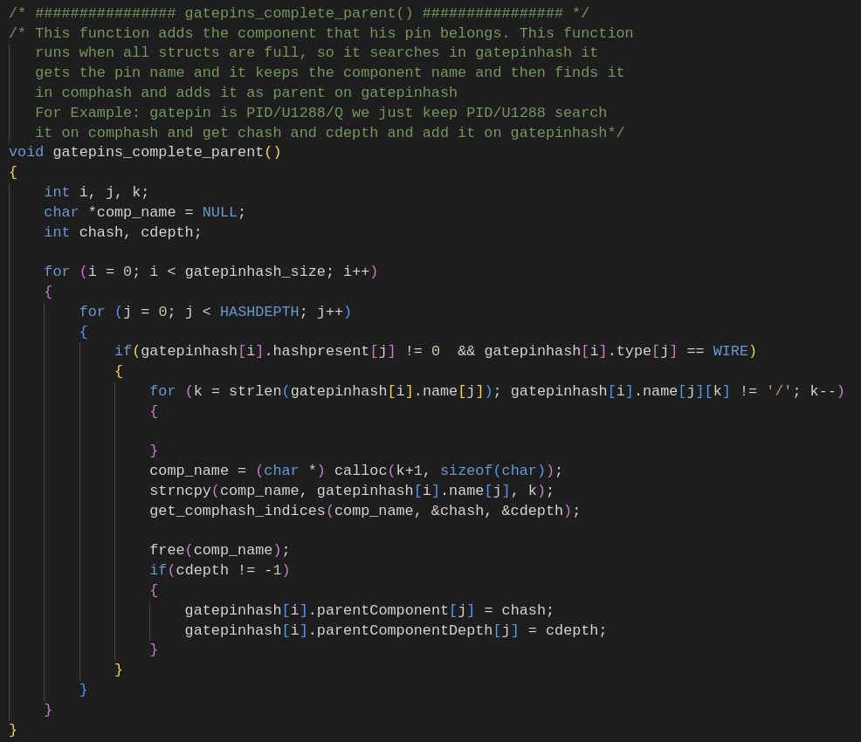
After Parsing
Now there are two fields that are empty:
On gatepinsh the field that specifies which component they belong
IOs type (if they are Input or Output)
We don't parse file again to fill these fields. We have already the hashtables with components and gatepins, so we take first part of gatepin name (which is component name) and we find hash and depth on comphash and pass them on gatepin
For IOs type, we get the from gatepinhash all IOs and check if first connection is Output or input. In case it has not connections we suppose that it is Input. In this way we fill this field.

Slide 58
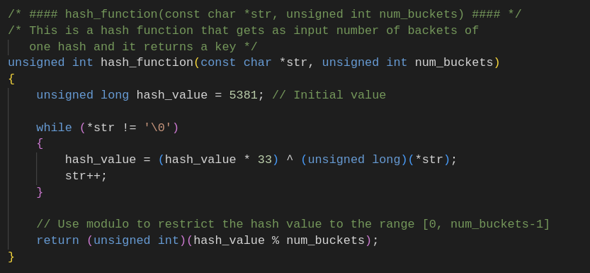
Hash Function
Hash Function that returns the position of bucket according to size of hash table

Slide 59
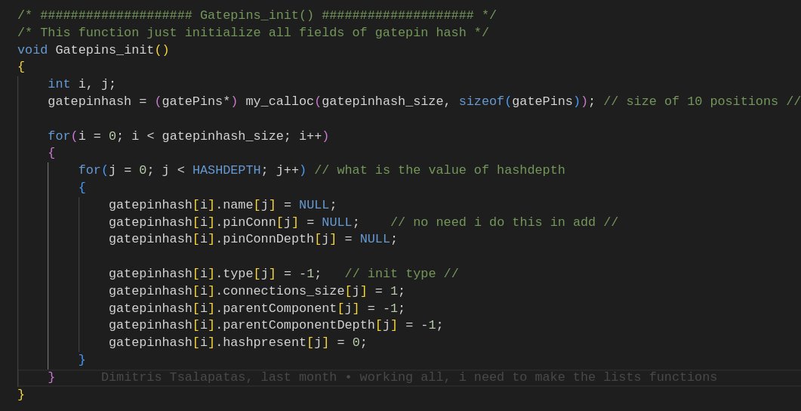
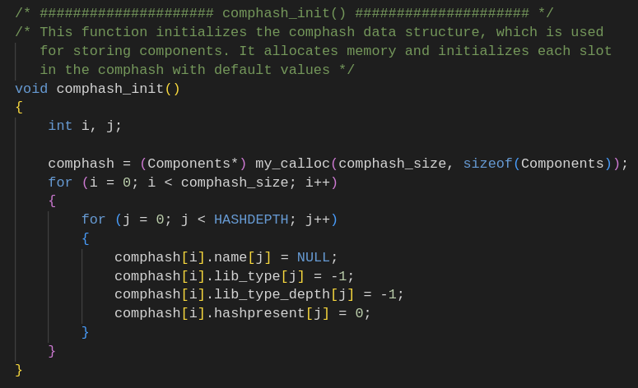
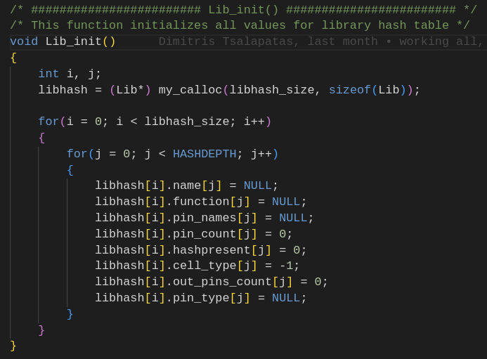
Structs Initialazation

Slide 60
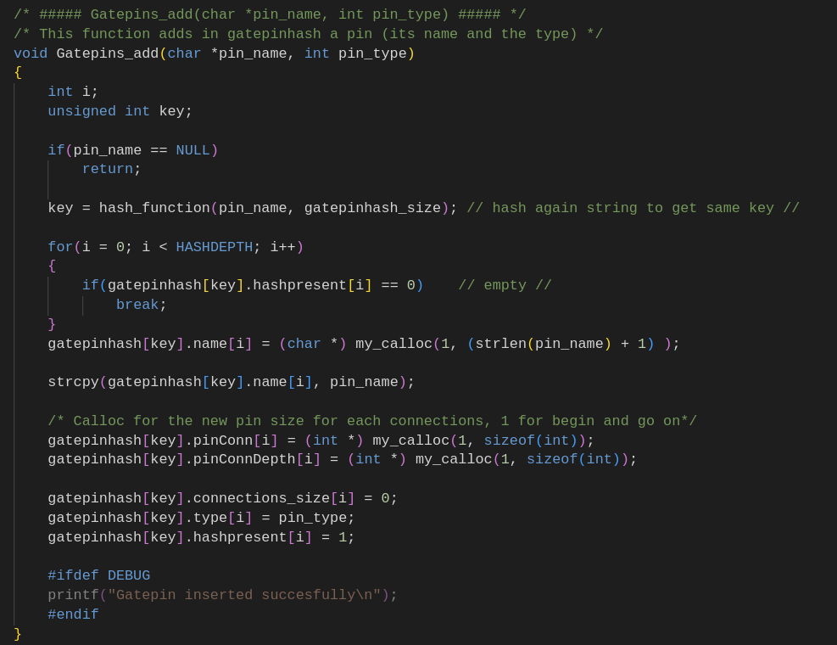
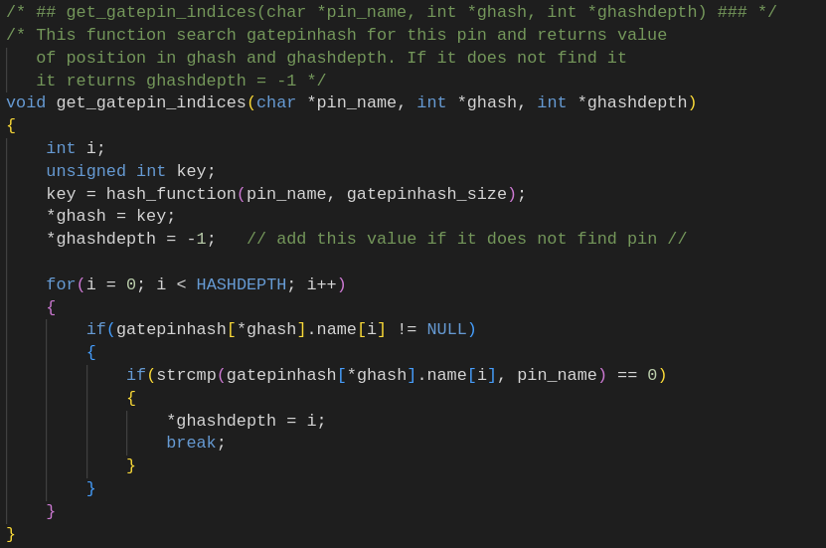
Functions for gatepinhash
Gatepins_add
Get_gatepin_indices

Slide 61
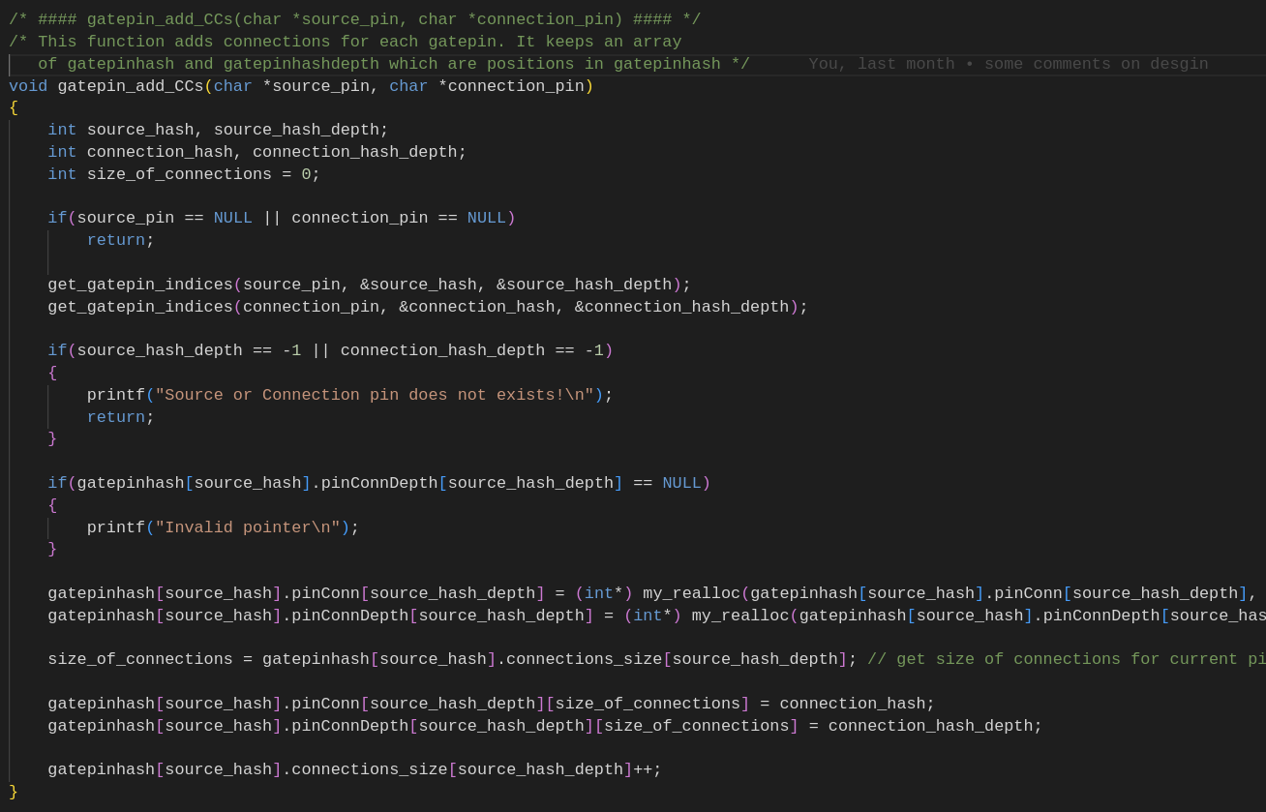
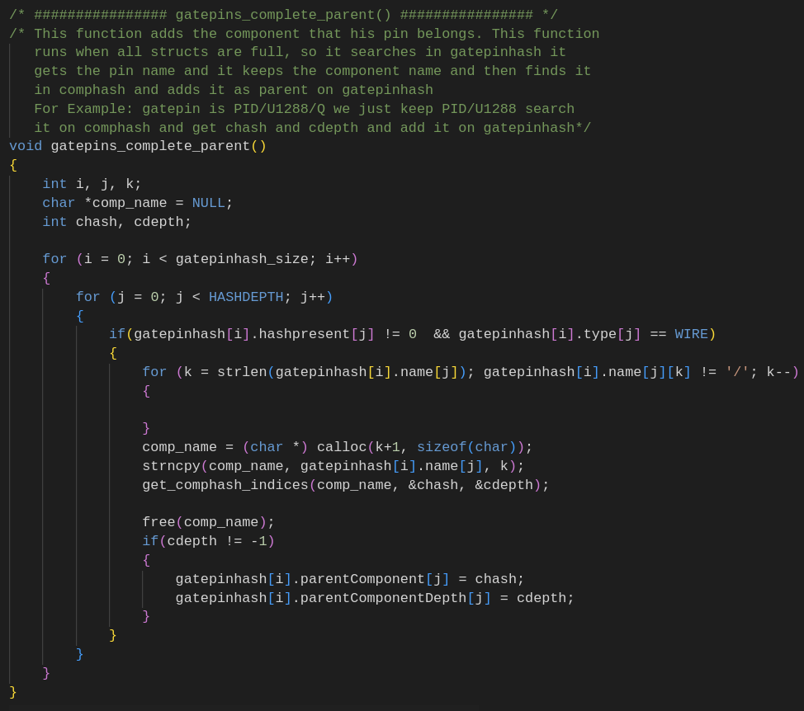
Functions for gatepinhash
gatepin_add_CCs
gatepins_complete_parent

Slide 62
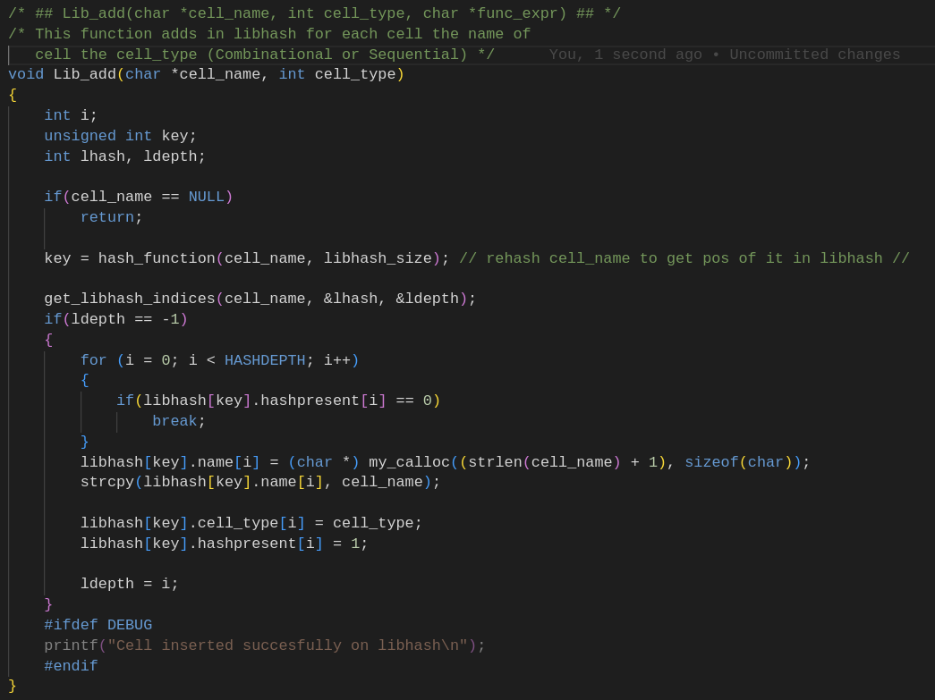
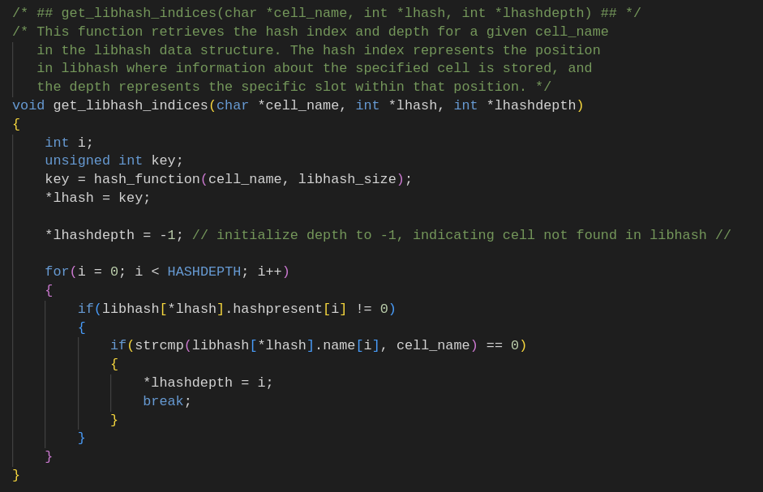
Functions for Libhash
Lib_add
get_libhash_indices

Slide 63
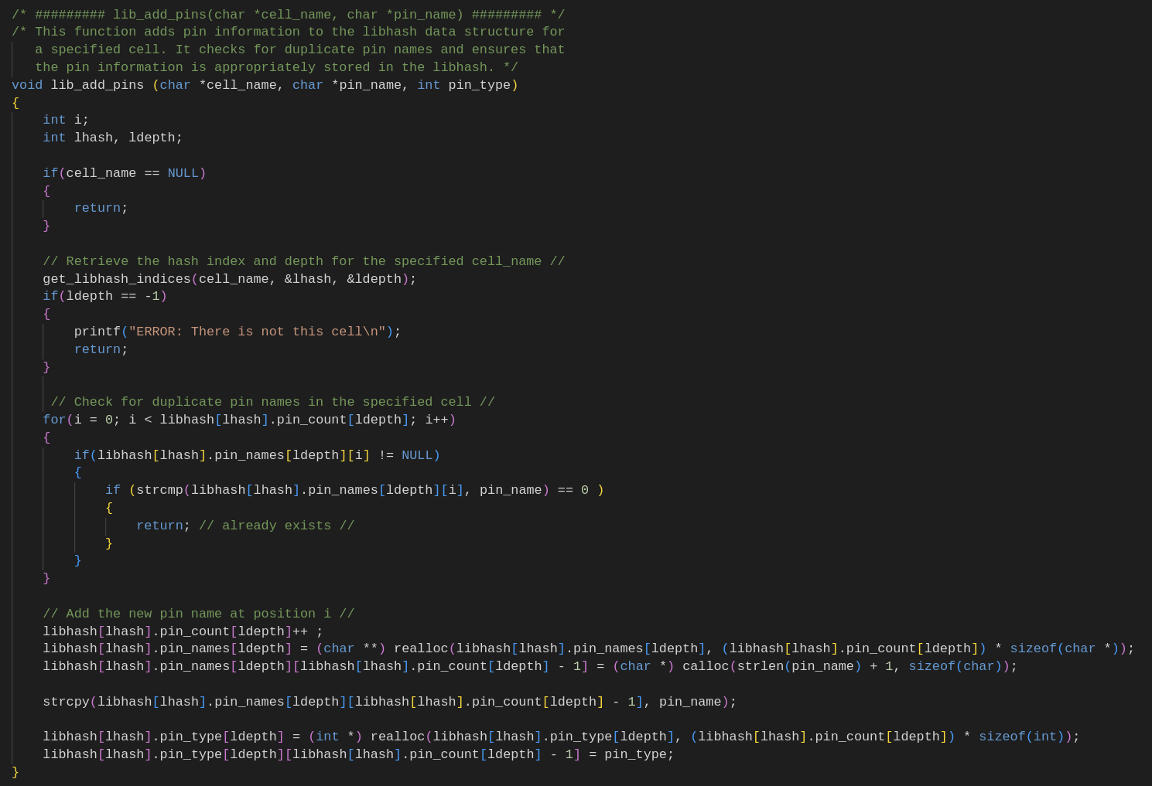
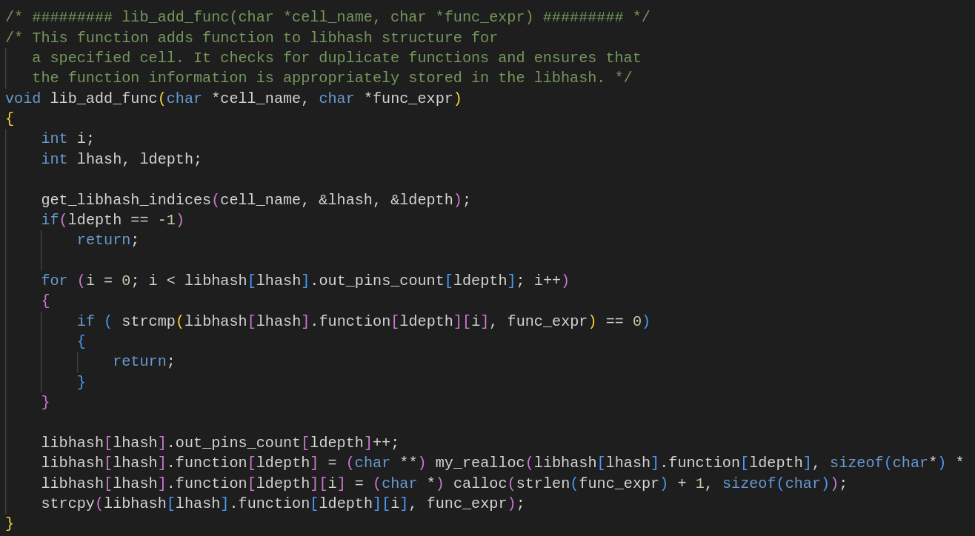
Functions for Libhash
Lib_add_pins
Lib_add_func

Slide 64
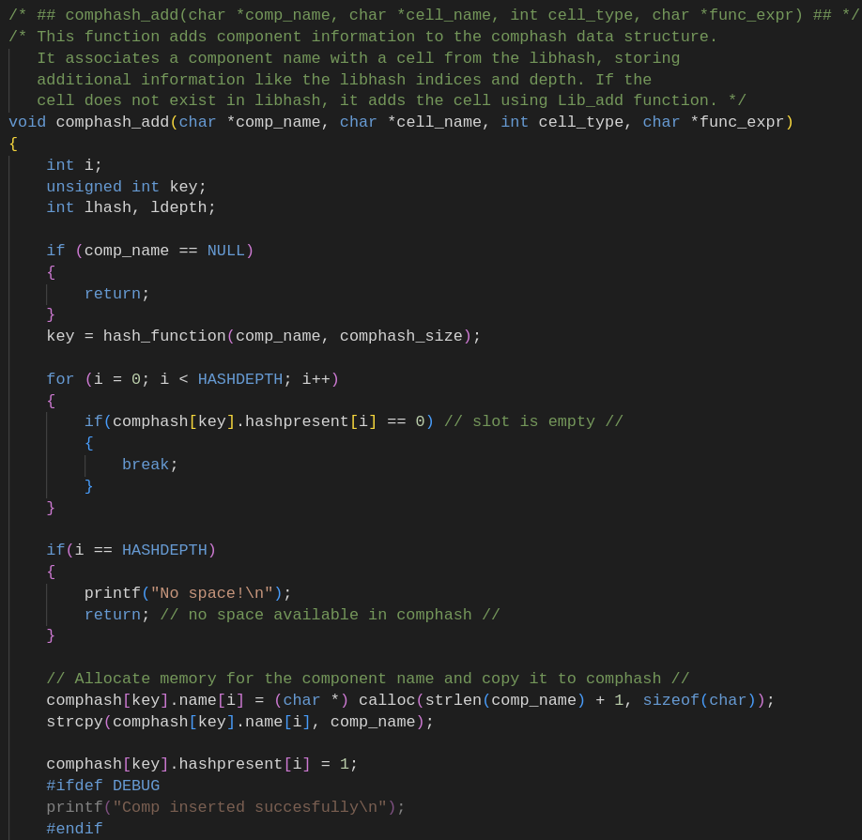
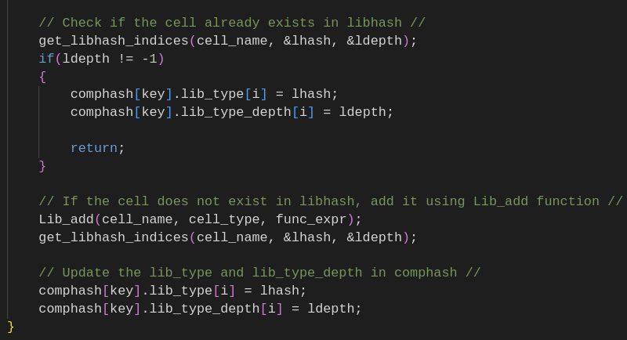
Functions for Comphash
Comphash_add

Slide 65
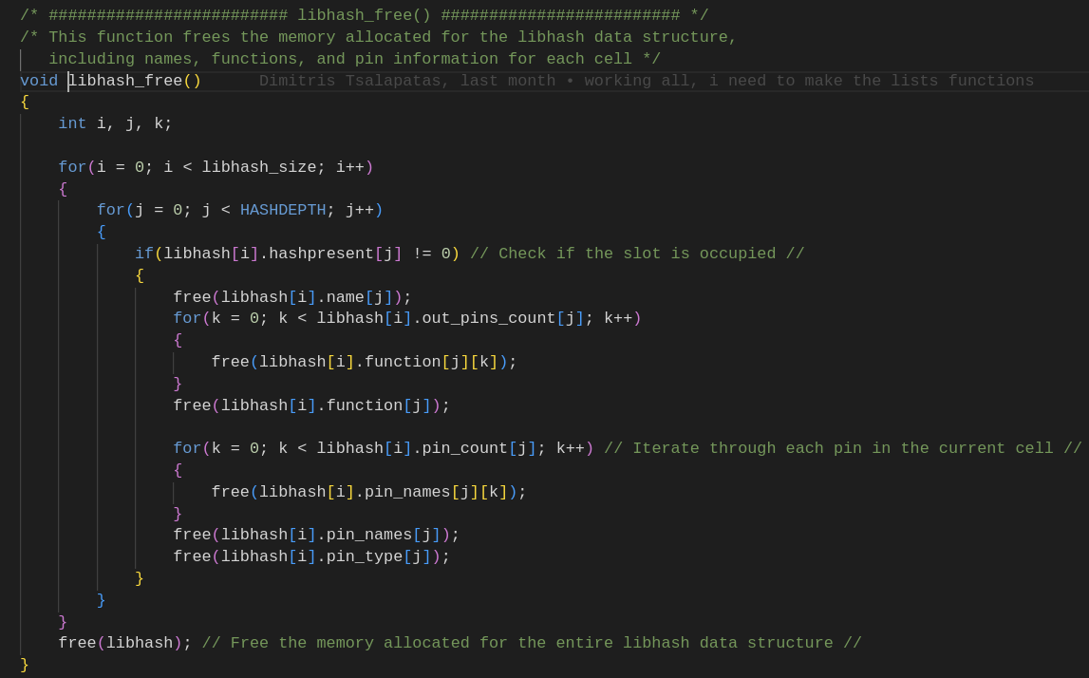
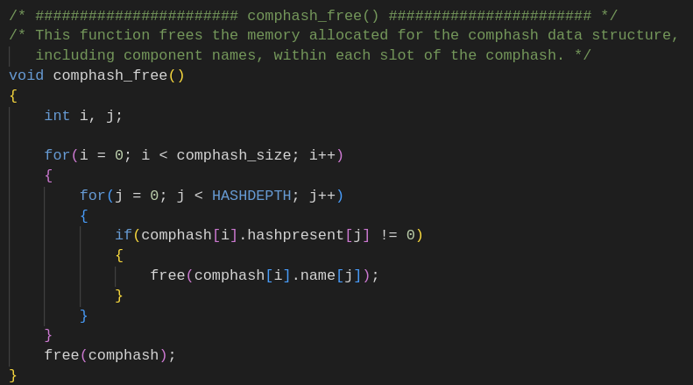
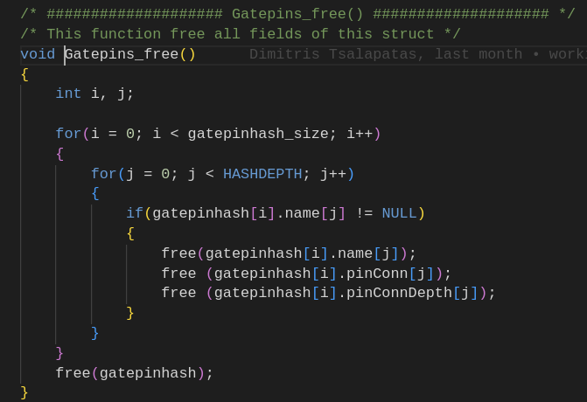
Structs Free

Slide 66
Supported TCL commands
Read_design: Read current file
List_IOs: List all IOs of design and their connections
List_components: print a TCL list with all components of design
Report_component_function: Print functions for each output pin of given component
Report_component_type: Print type of component (Combinational or Sequential)
List_component_CCS: Print connections of current component
List_IO_CCS: Print connections of current IO
List_cell: Print all fields of given cell
List_cells: Print all fields of all cells of design
List_component_info: Print cell type and connections of given component
List_components_info: Print cell type and connections of all components
Clear_design: Clear and free all structures

Slide 67
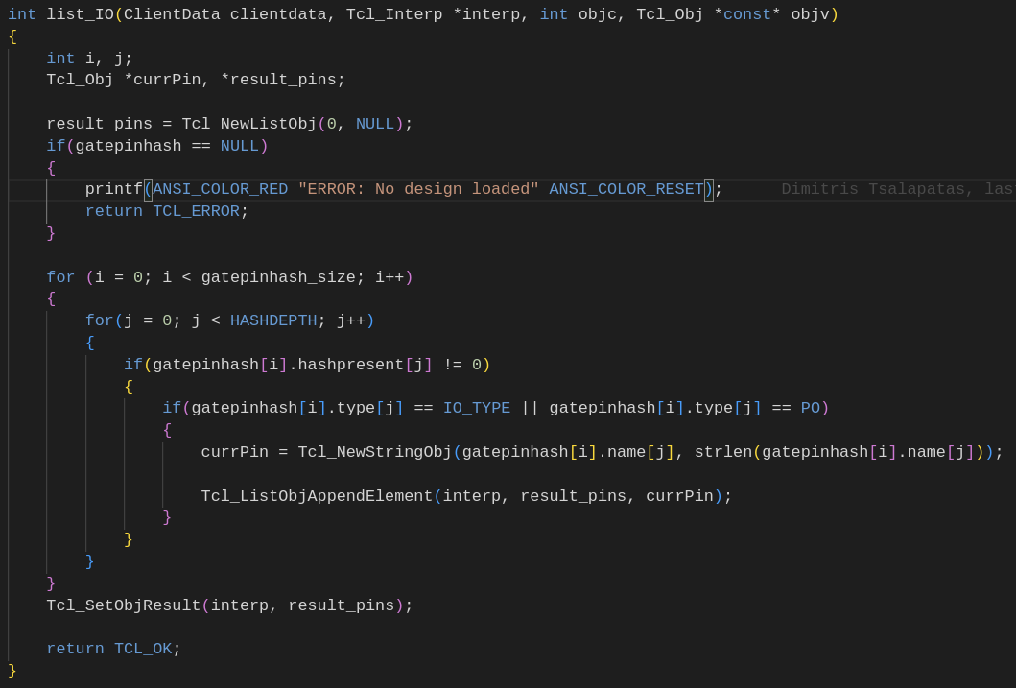
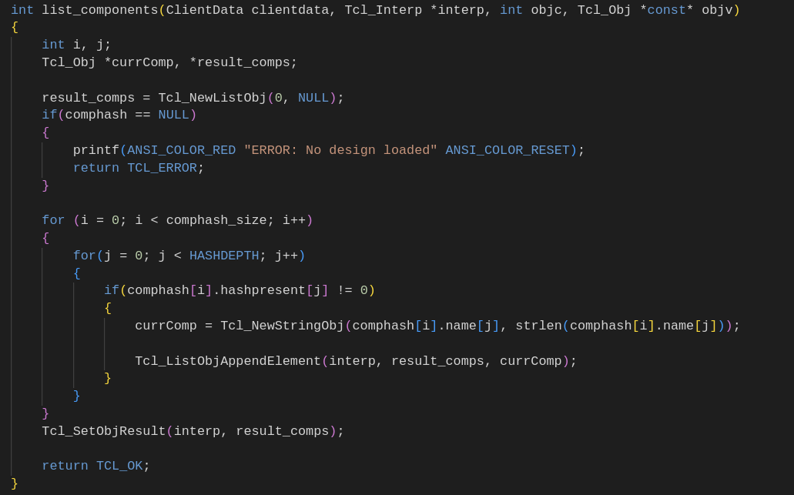
Some Examples

Slide 68
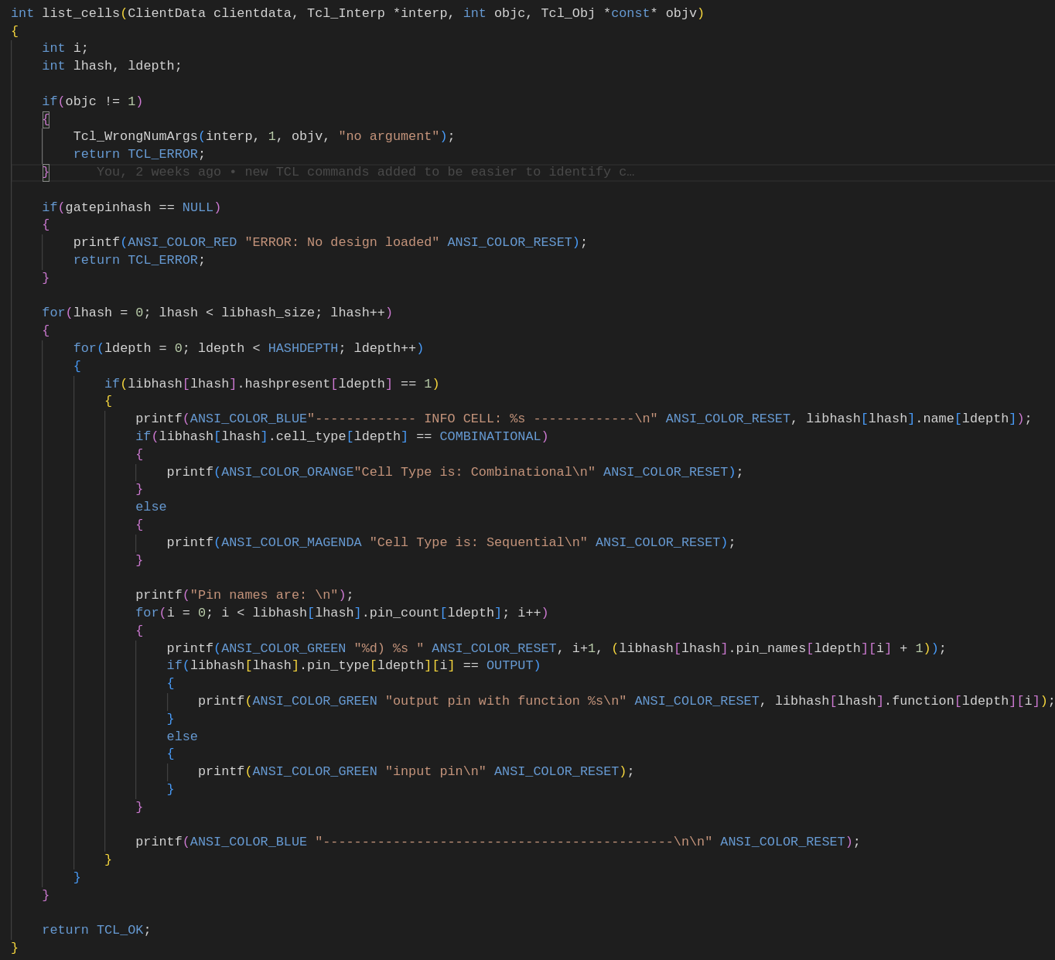
Some Examples

Slide 69
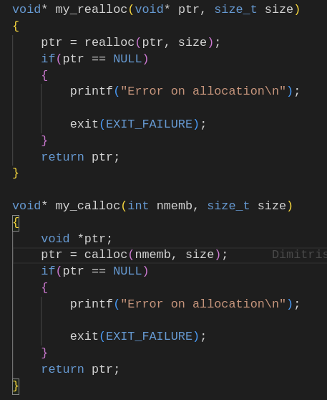
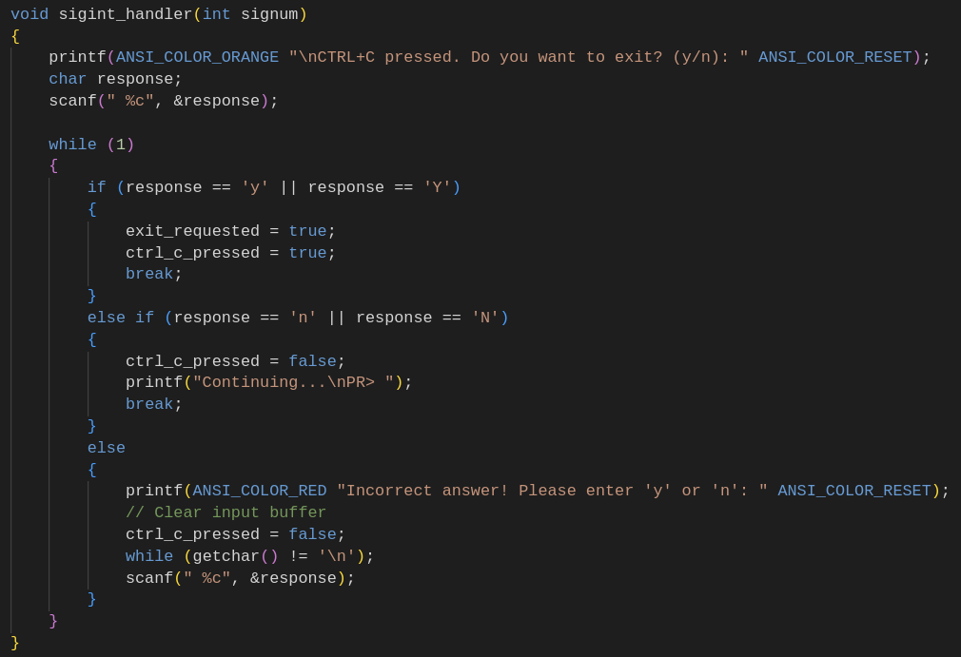
Extras
Custom functions for realloc and calloc to don't check return value every time
Signal handler for CTRL+C (interrupt program) to ask user if really wants to exit

Slide 70
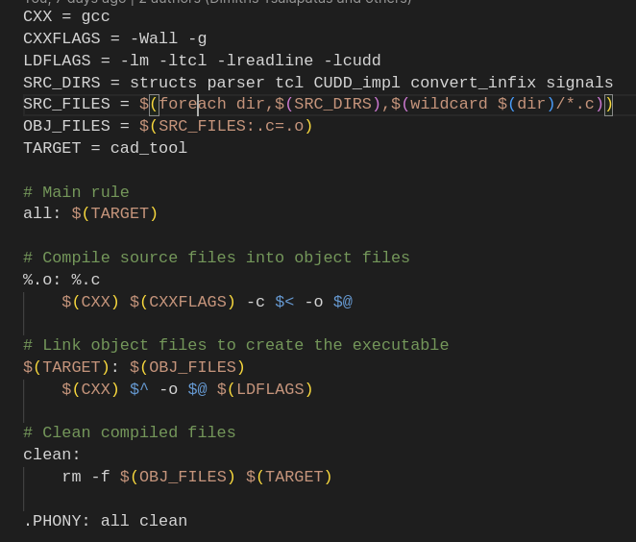
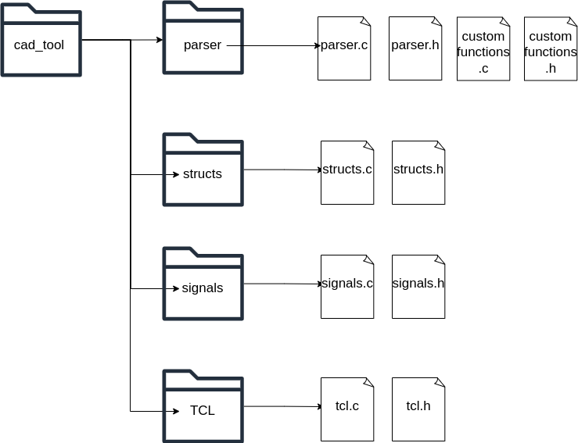
Makefile

Slide 71

Thank you for your attention!
Do you have any questions?

